Slide 1
Exploring India’s response and options to COVID-19
Anupam Saraph and Anab Kidwai

Slide 2
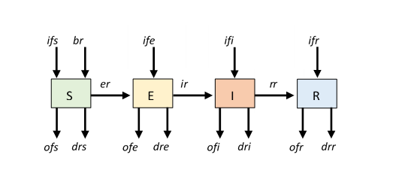
Overview of the SEIR Model

Slide 3
Simulating the First 146 Days in India

Slide 4
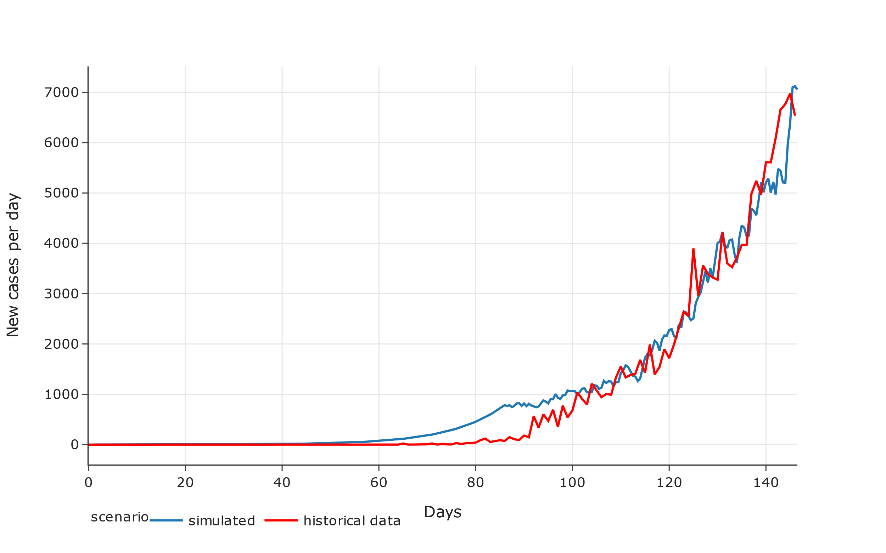

Slide 5
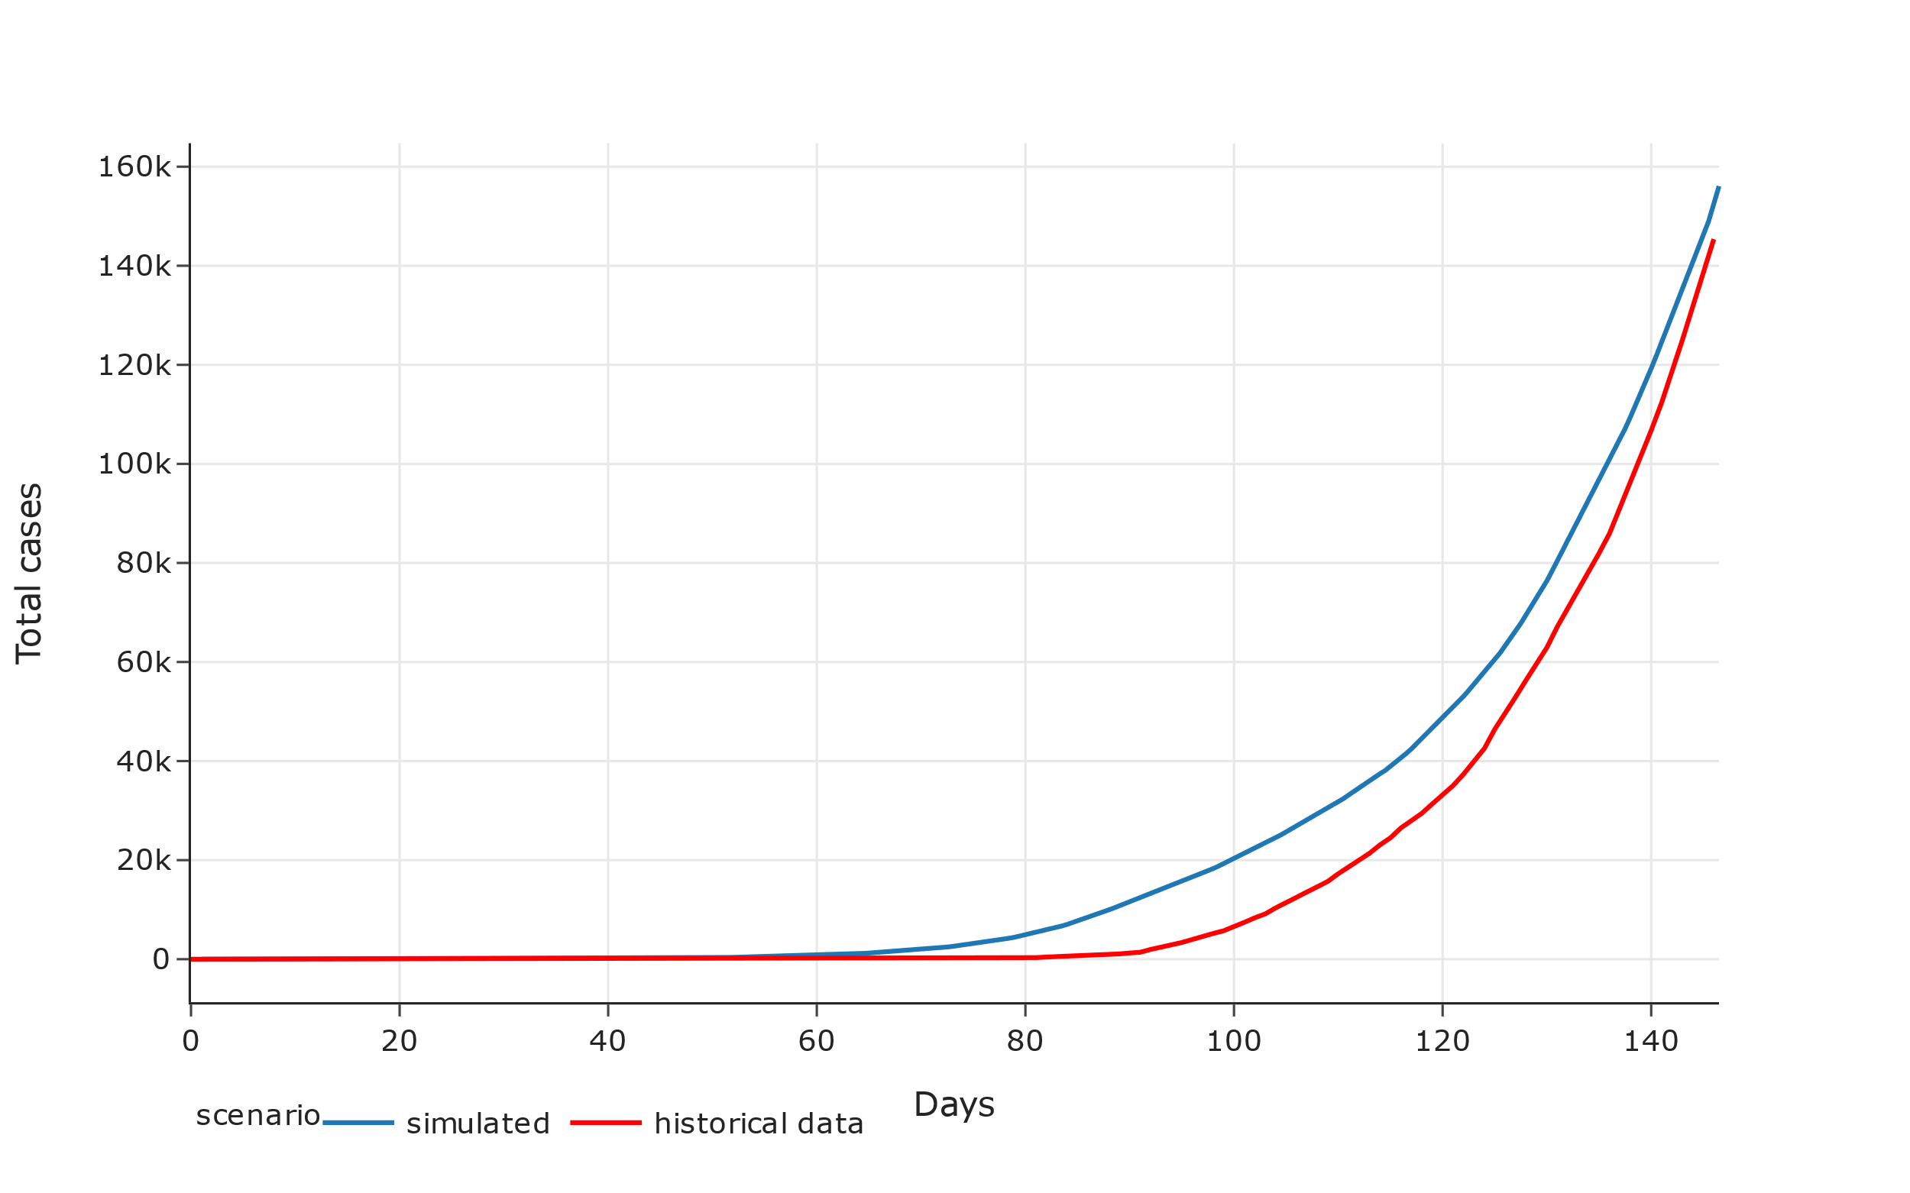

Slide 6
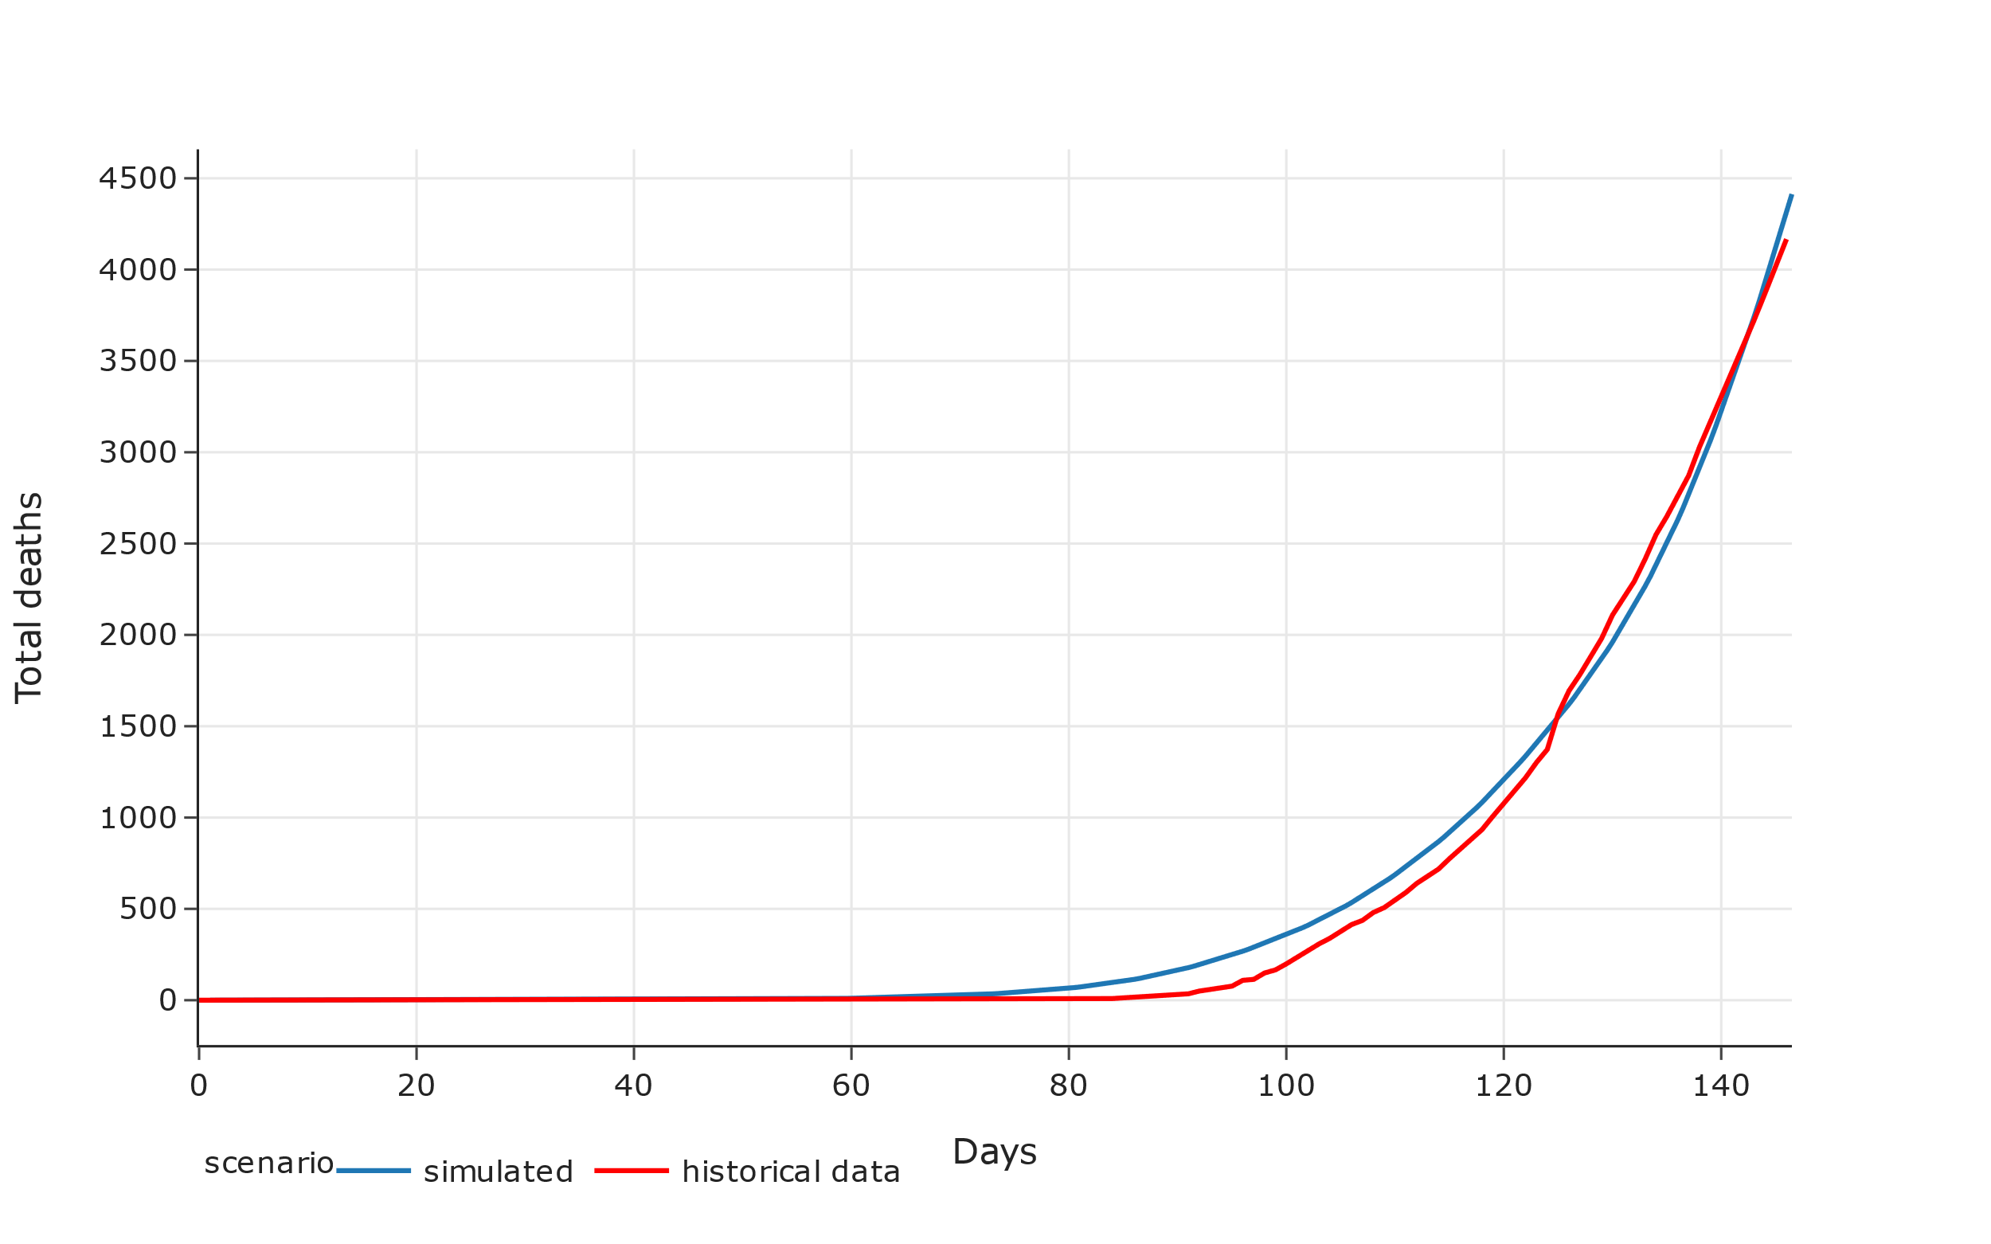

Slide 7
Had there been no Lockdown

Slide 8
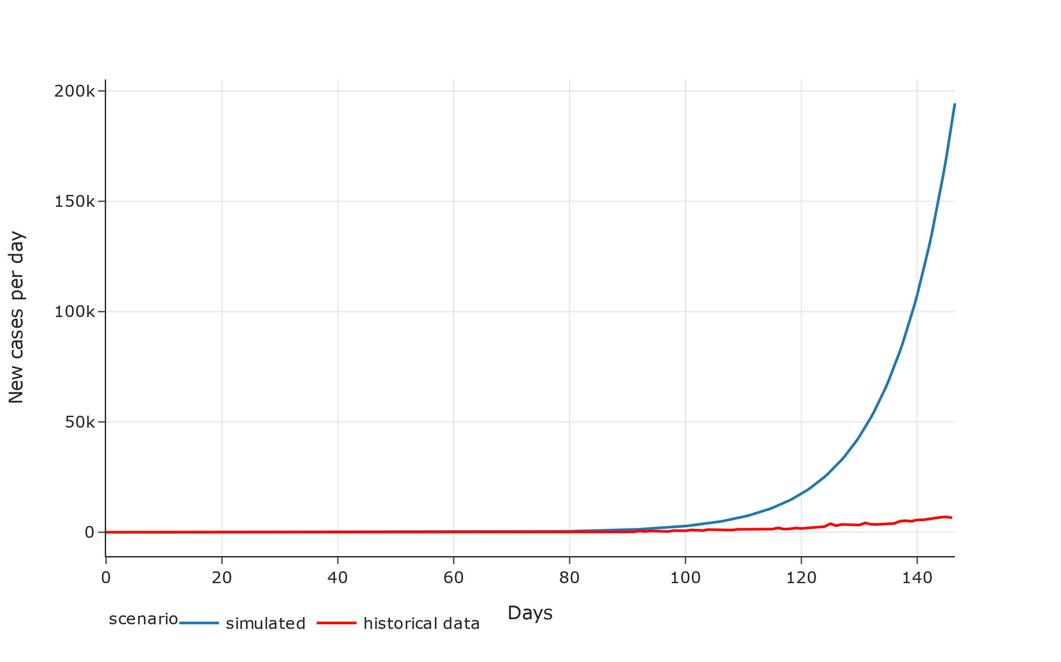

Slide 9
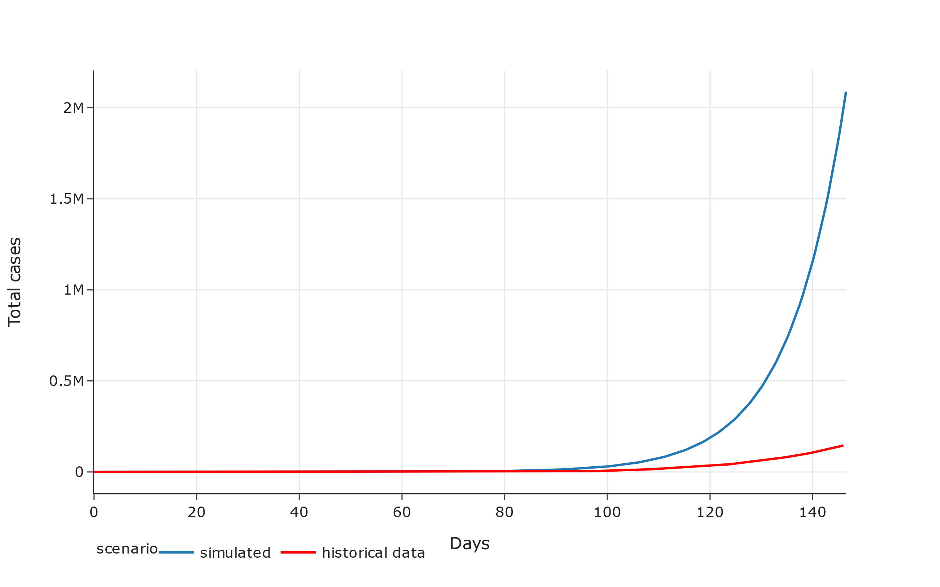

Slide 10
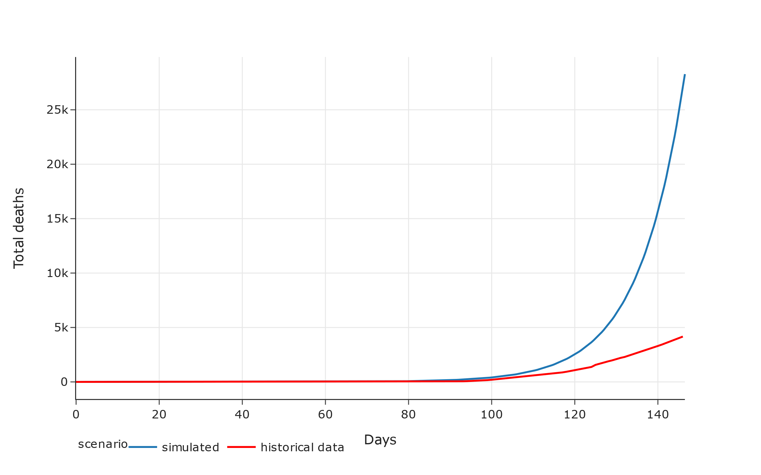

Slide 11
Government Intervention
 | Description | From | To | Days
Lockdown 1st phase | Closure of all activities except essential services, restriction of movements | 25.03.2020 | 14.04.2020 | 21
Lockdown 2nd phase | Closure of all activities except essential services, restriction of movements | 15.04.2020 | 03.05.2020 | 20
Lockdown 3rd phase | Closure of all activities except essential services, restriction of movements | 04.05.2020 | 17.05.2020 | 14
Lockdown 4th phase | Opening up of most activities except those creating mass contacts, restriction on movement | 18.05.2020 | 31.05.2020 | 14
Lockdown 5th phase | 3 phase opening up of most activities | 1.06.2020 | 30.06.2020 | 30
Close international borders | Inflow and outflow of population from the country restricted. | 22.03.2020 | ongoing
Mask Program | Ministry of Health and Family Welfare Advisory | March 2020 | .. | ..
Immunity Boost Program | Ministry of AYUSH advisory | April 2020 | .. | ..
Quarantine Program | Isolation of those infected and quarantine of those traveling | 04.05.2020 | .. | ..
Migrant Flow | Permission for migrants to return home | 29.04.2020 | .. | ..

Slide 12
Scenarios Explored for Options Before India
Intervention | Effect of lockdown | Effect of under-capacity all scenarios under conditions where the hospital under-capacity has no impact on death (scenarios with a prefix C-) and scenarios where the increasing under-capacity has a multiplier effect on death rate of infected (scenarios with prefix U-)
Lockdown scenarios (L-1): Person-to-person contact rates per day from one (stringent lockdown) to one hundred and one (no lockdown) at intervals of ten. The L-1 scenarios are control scenarios where no other option is exercised by the government | 11 scenarios of person-to-person contact rate from 1-101 at interval of 10
Closure scenarios (C-0, C-0.99): 99 percent effective closure of international inflow and outflow (C-0.99) and opening of borders, or reversal of closure, by restoring inflow and outflow across national borders (C-0)
Mask scenarios (M-0.1, M-0.5): where masks have just ten percent effectiveness (M-0.1) in reducing infectivity and others where they have fifty percent effectiveness (M-0.5)
Isolation scenarios (Q-0.1, Q-0.5): ten percent (Q-0.1) and fifty percent (Q-0.5) reduction of exposed and infected individuals coming in contact with the susceptible population
Immunity scenarios (I-0.1, I-0.5): ten percent (I-0.1) and fifty percent (I-0.5) reduction of susceptible individuals due to immunity
Uncertainty explored in a possibility of 198 scenarios simulated over 1825 days (5 years)

Slide 13
5 Year Scenarios for India

Slide 14
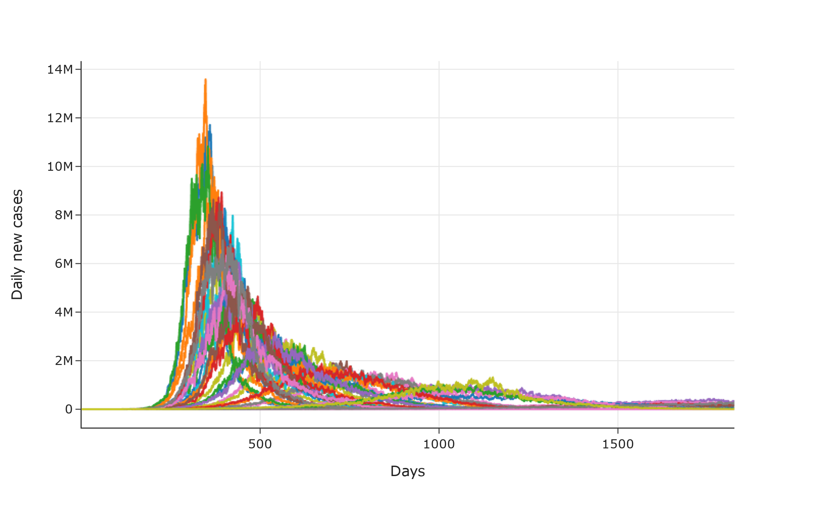
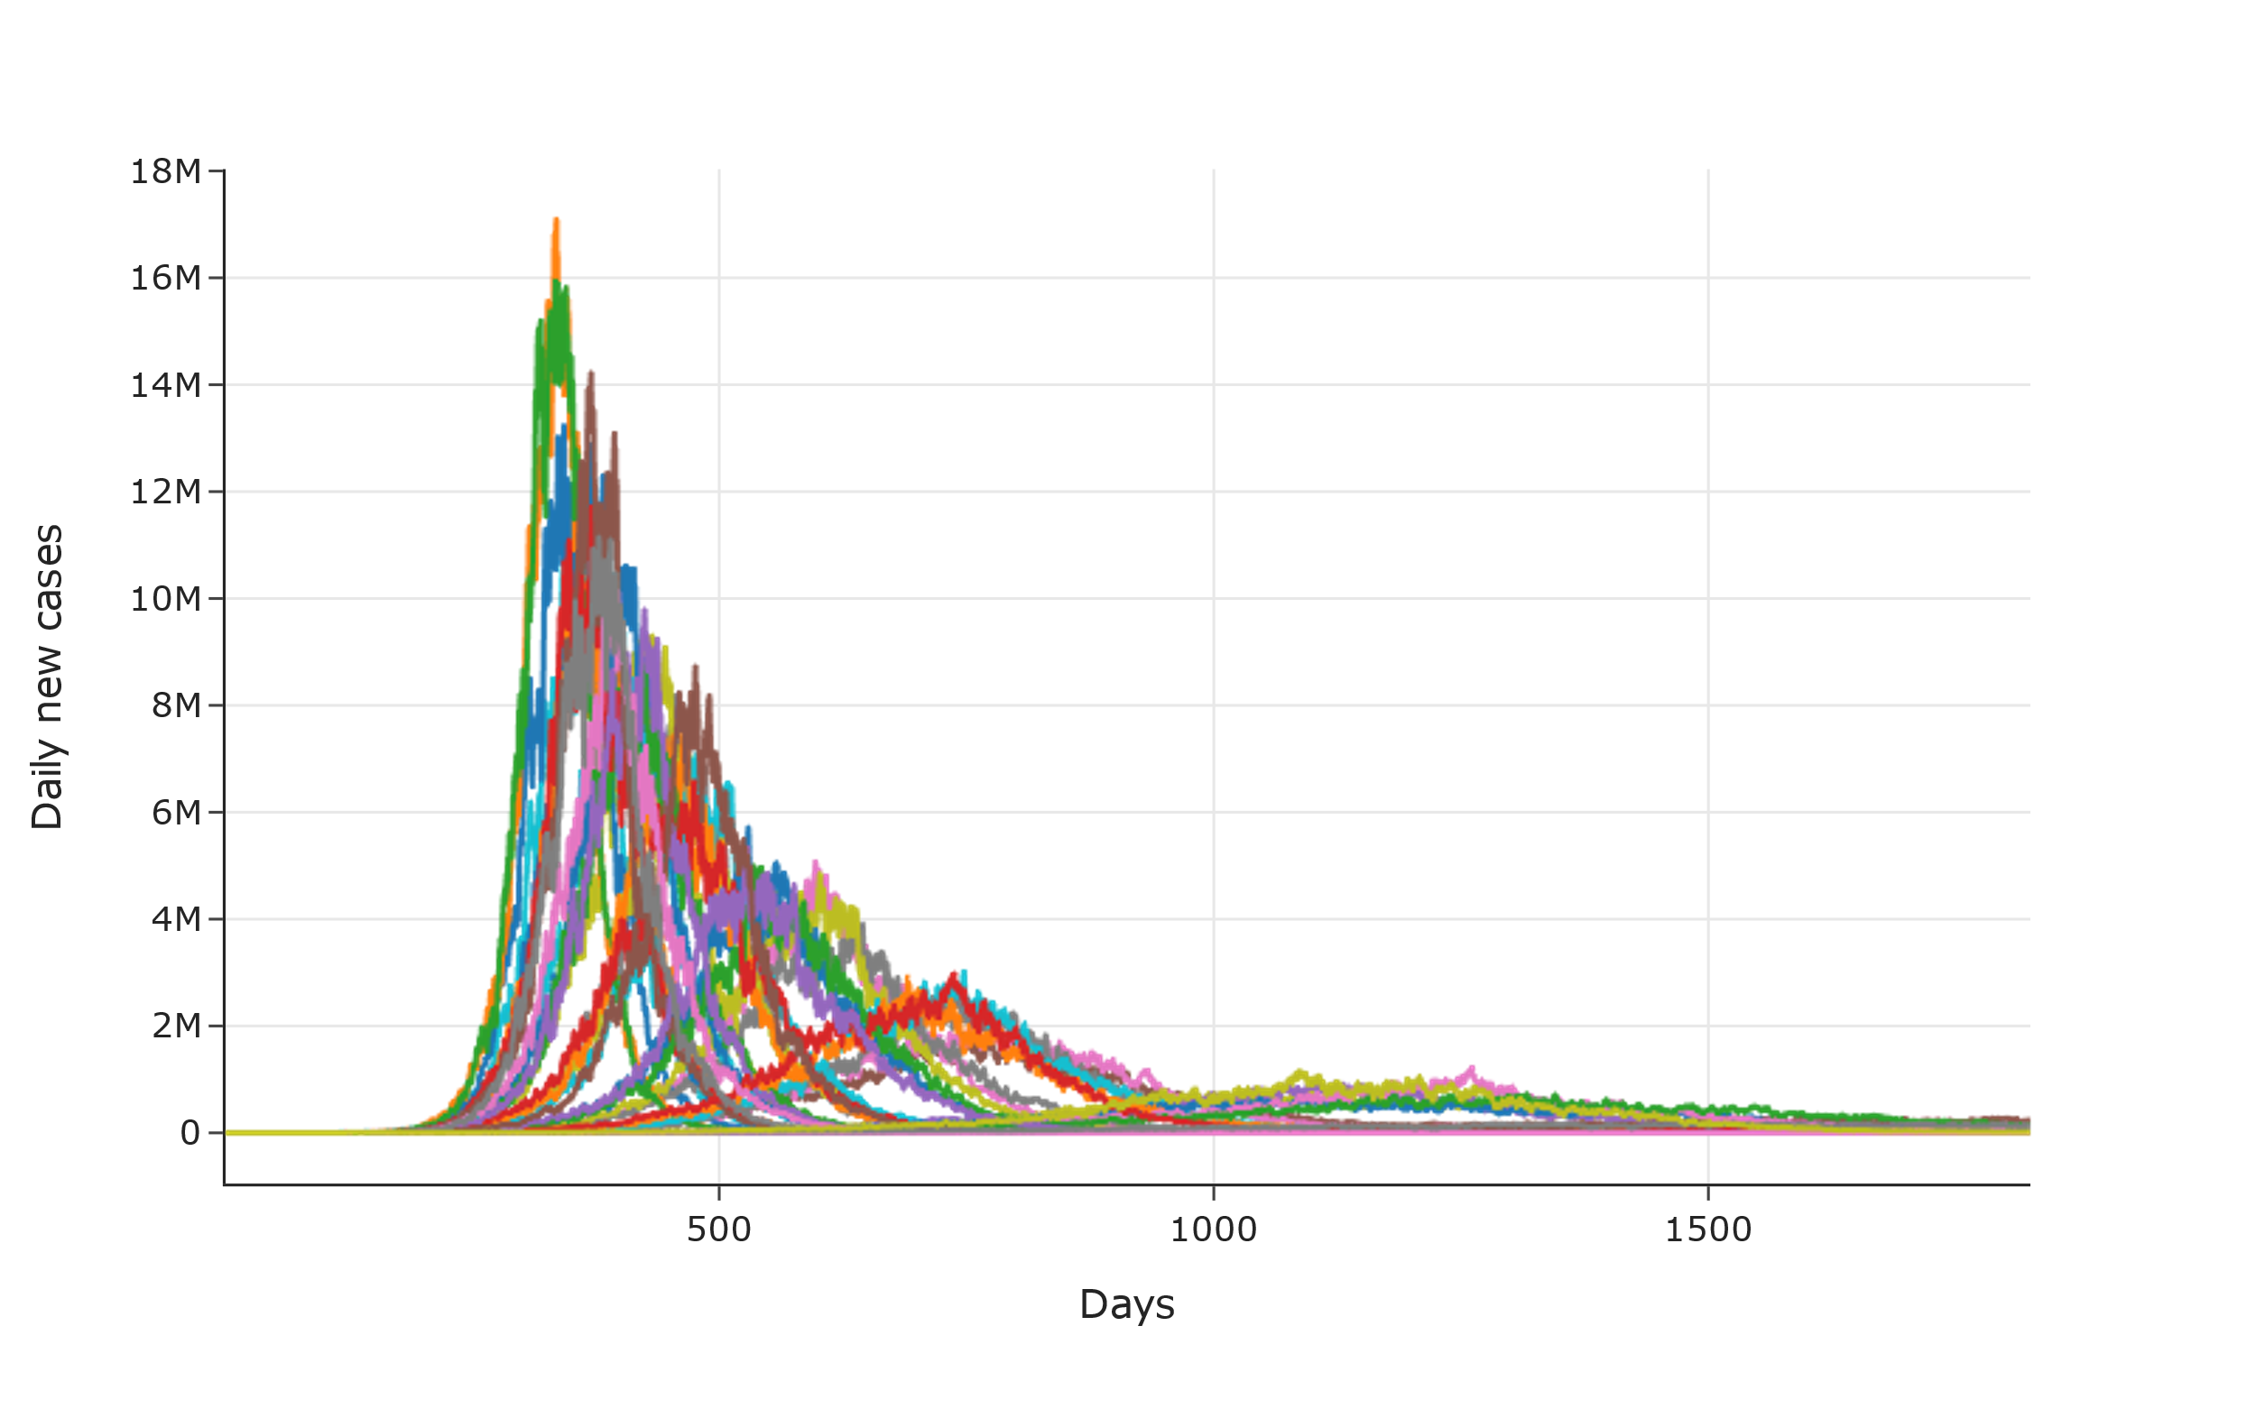
Scenarios where under-capacity of hospitals has no impact on deaths
Scenarios where under-capacity of hospitals has a multiplier effect on deaths

Slide 15
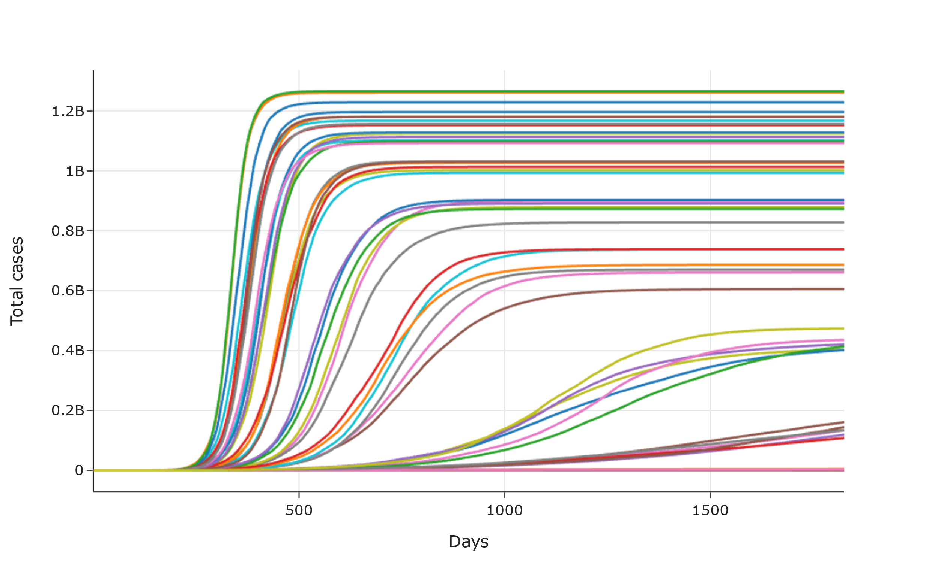
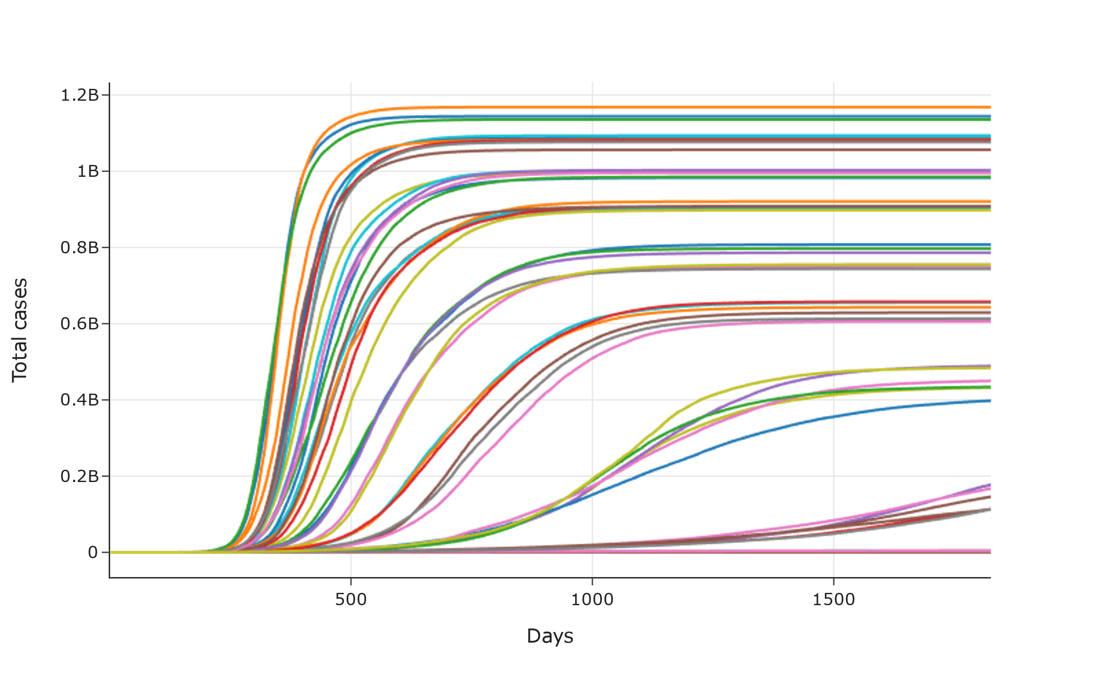
Scenarios where under-capacity of hospitals has no impact on deaths
Scenarios where under-capacity of hospitals has a multiplier effect on deaths

Slide 16
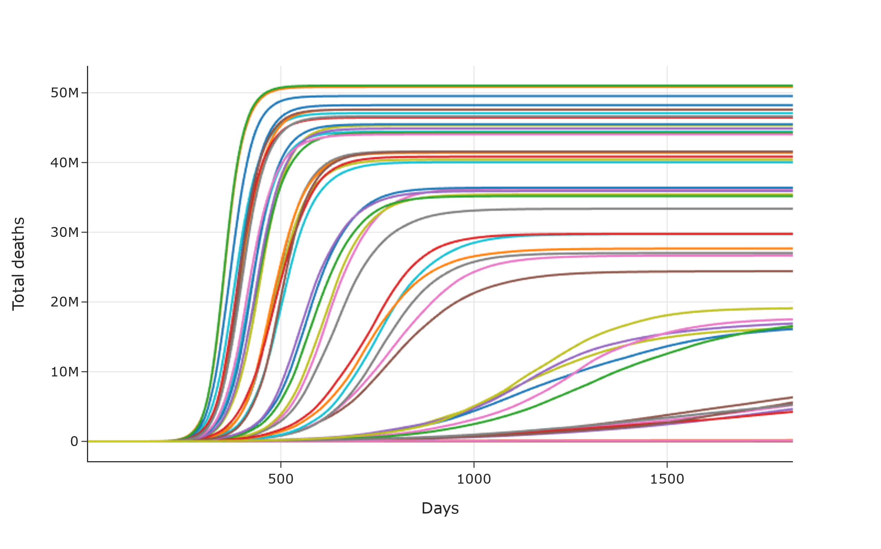
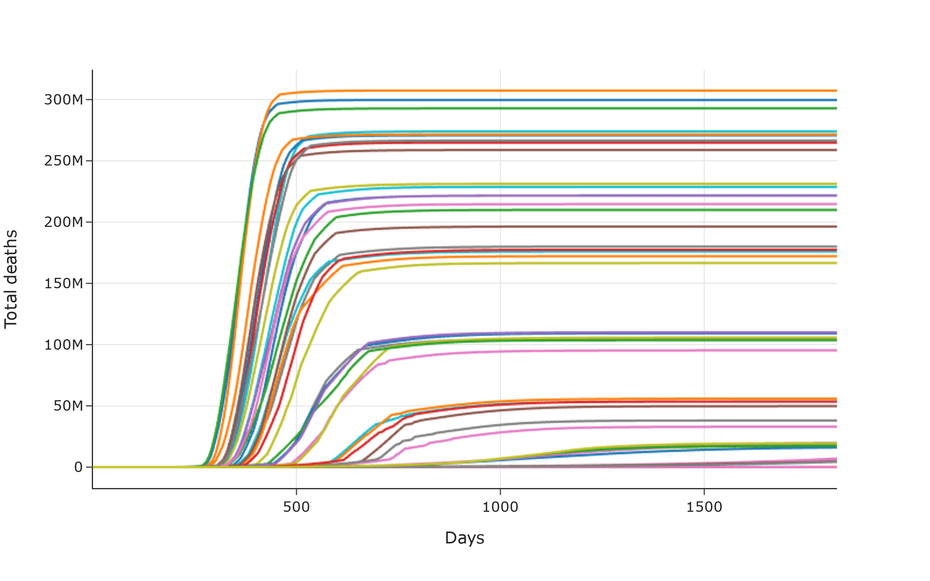
Scenarios where under-capacity of hospitals has no impact on deaths
Scenarios where under-capacity of hospitals has a multiplier effect on deaths

Slide 17
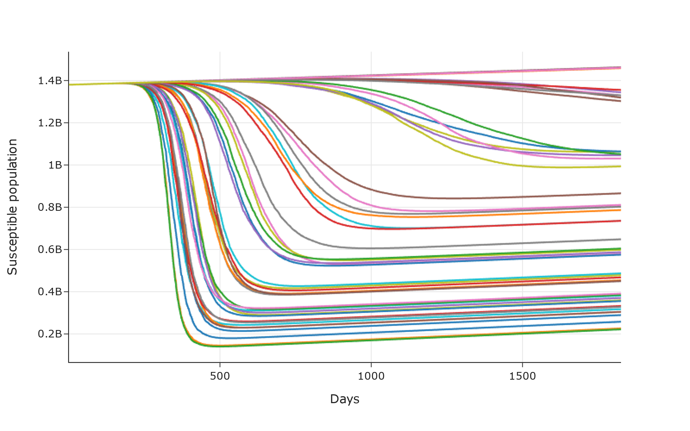
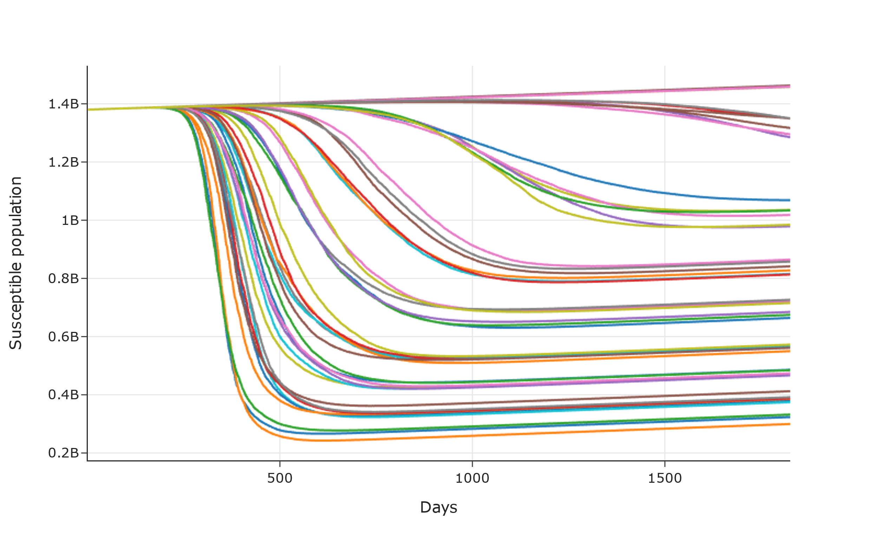
Scenarios where under-capacity of hospitals has no impact on deaths
Scenarios where under-capacity of hospitals has a multiplier effect on deaths

Slide 18
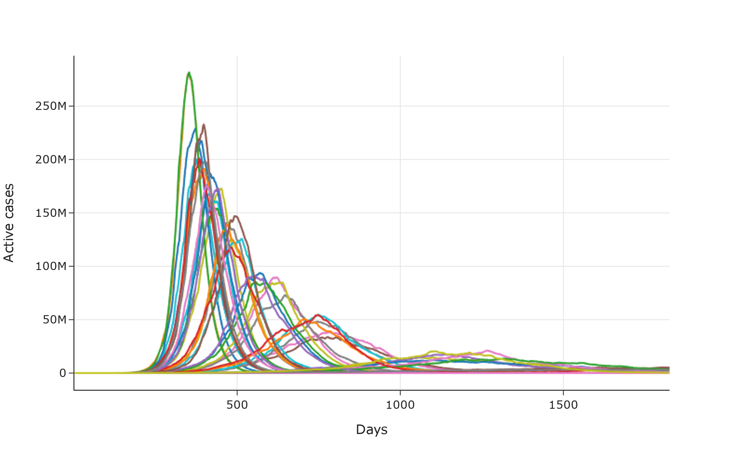
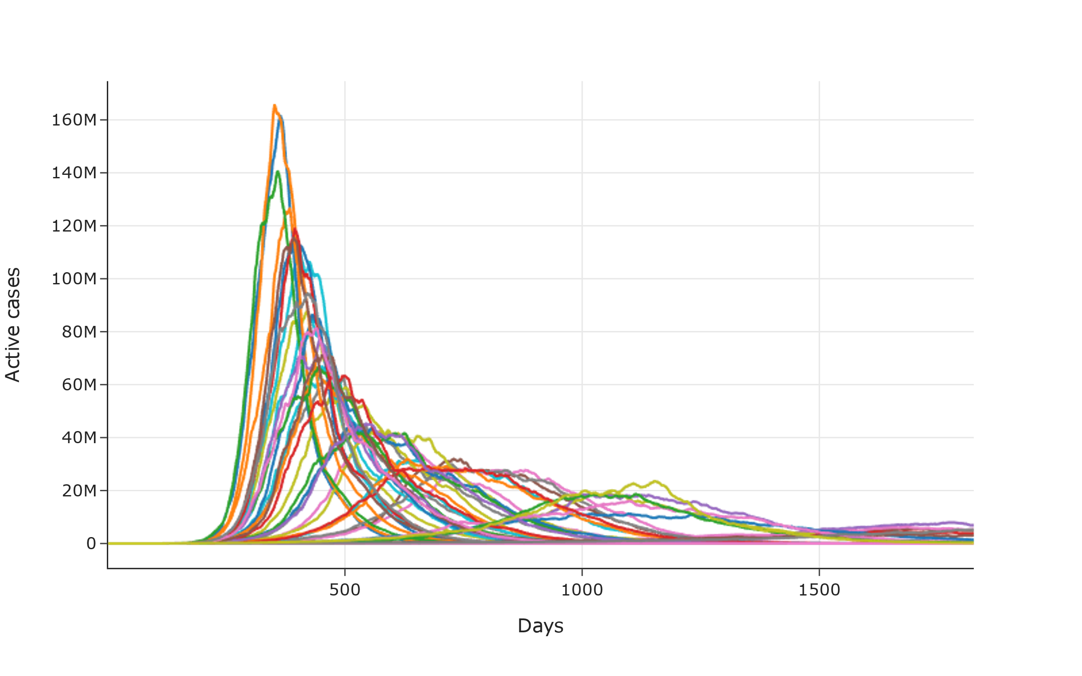
Scenarios where under-capacity of hospitals has no impact on deaths
Scenarios where under-capacity of hospitals has a multiplier effect on deaths

Slide 19
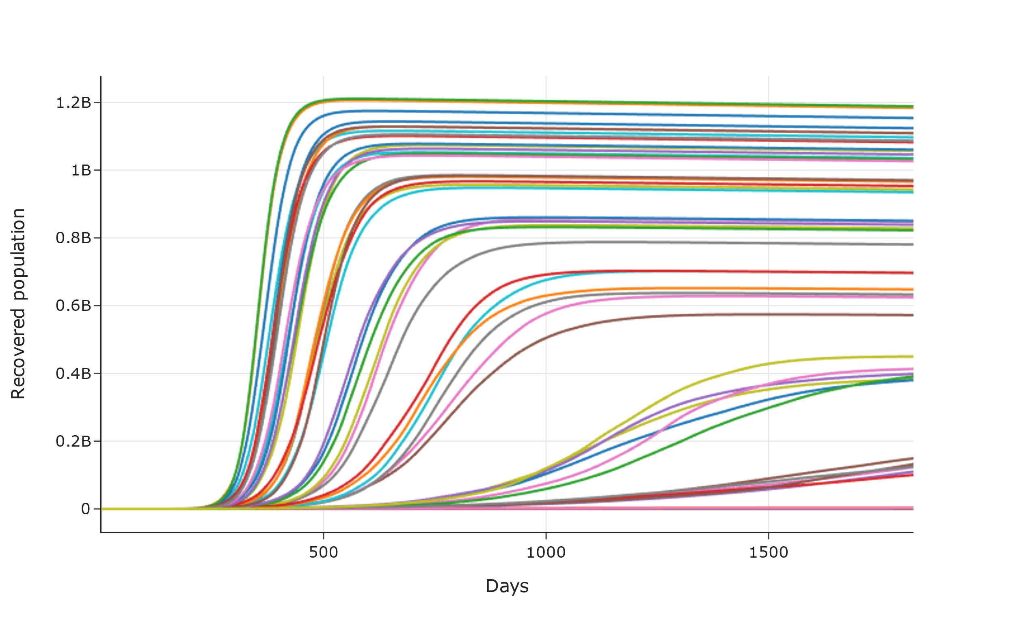
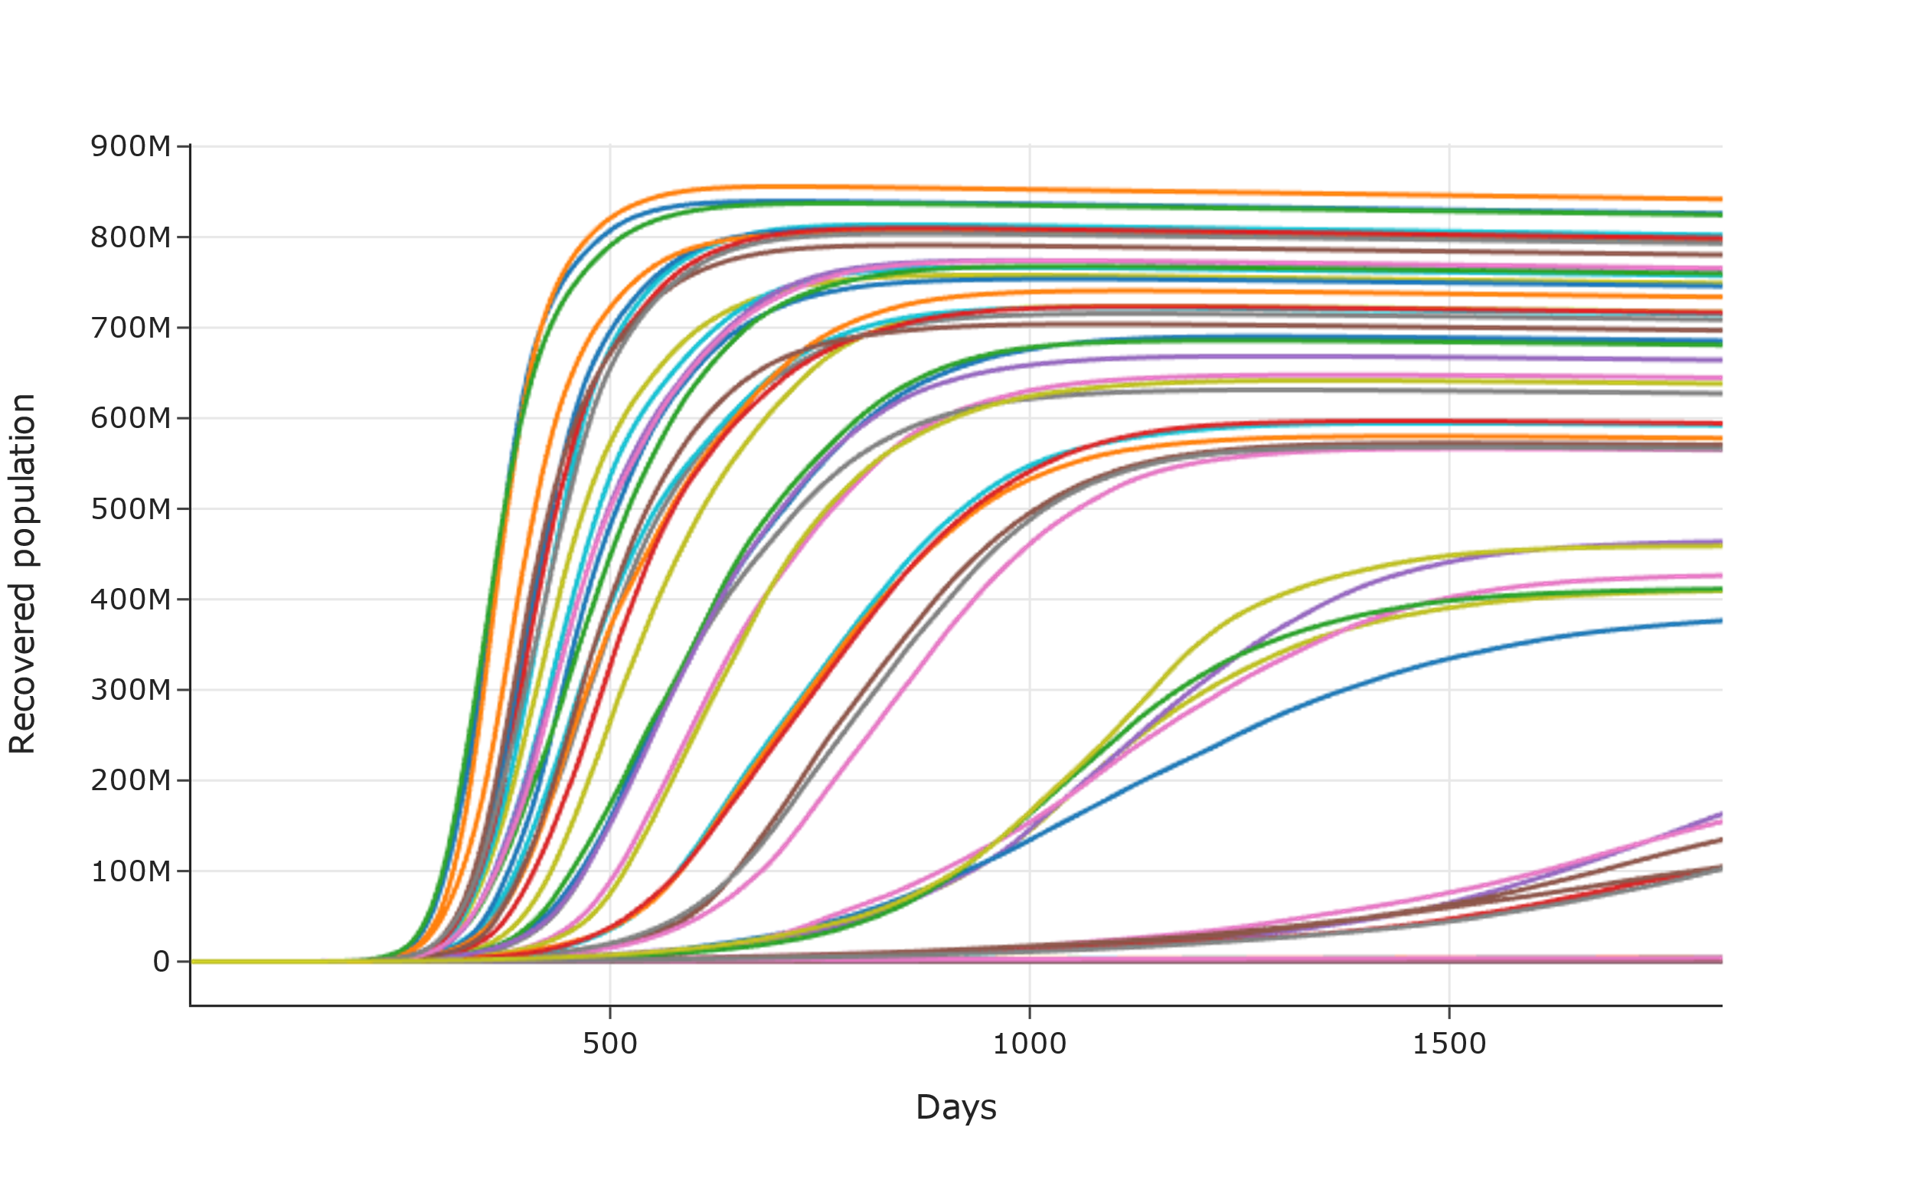
Scenarios where under-capacity of hospitals has no impact on deaths
Scenarios where under-capacity of hospitals has a multiplier effect on deaths

Slide 20
Flattening the Curve

Slide 21
Peak value of new cases per day
 |  |  | 1 | 11 | 21 | 31 | 41 | 51 | 61 | 71 | 81 | 91 | 101
C | C | 0.99 | 4,587 | 7,460 | 5,334 | 7,162 | 245,959 | 2,073,624 | 3,937,306 | 7,072,608 | 10,448,619 | 12,879,576 | 17,085,782
C | C | 0 | 6,194 | 6,242 | 4,935 | 7,408 | 217,500 | 2,529,683 | 4,837,944 | 7,110,403 | 10,604,882 | 10,360,040 | 15,943,218
C | Q | 0.1 | 8,463 | 5,941 | 5,450 | 5,864 | 8,077 | 654,432 | 2,921,187 | 4,988,655 | 6,615,672 | 9,787,283 | 14,217,075
U | C | 0.99 | 6,991 | 5,516 | 7,203 | 6,079 | 304,938 | 1,688,364 | 3,100,761 | 4,230,356 | 6,295,239 | 8,476,889 | 13,583,619
C | L | 1 | 9,375 | 10,547 | 5,151 | 6,327 | 215,815 | 1,913,802 | 5,071,657 | 8,172,372 | 9,302,424 | 11,986,827 | 13,223,767
U | L | 1 | 6,164 | 6,505 | 6,825 | 6,120 | 423,288 | 1,974,722 | 2,877,982 | 4,701,162 | 6,443,579 | 8,183,266 | 11,712,507
C | I | 0.1 | 7,749 | 8,152 | 8,595 | 5,844 | 7,516 | 801,634 | 3,012,988 | 5,717,553 | 8,187,094 | 8,792,211 | 11,708,757
C | M | 0.1 | 9,555 | 5,253 | 8,060 | 10,403 | 7,116 | 722,004 | 2,978,141 | 5,341,495 | 8,726,723 | 10,176,435 | 11,147,864
U | C | 0 | 7,671 | 7,071 | 7,245 | 5,175 | 331,375 | 1,879,749 | 2,857,229 | 5,075,975 | 6,579,030 | 9,552,063 | 10,826,766
U | I | 0.1 | 7,366 | 6,296 | 3,730 | 5,846 | 6,393 | 1,028,507 | 2,059,474 | 3,154,419 | 5,142,001 | 5,184,251 | 8,931,440
U | Q | 0.1 | 6,599 | 6,101 | 6,392 | 7,004 | 7,921 | 632,060 | 1,962,238 | 2,890,691 | 4,640,265 | 6,026,868 | 8,625,834
U | M | 0.1 | 8,603 | 5,323 | 5,413 | 5,523 | 6,188 | 1,031,680 | 1,872,369 | 3,168,306 | 5,587,814 | 6,322,237 | 6,951,854
U | M | 0.5 | 7,745 | 7,254 | 5,601 | 5,045 | 6,465 | 7,062 | 5,517 | 7,825 | 7,151 | 288,749 | 1,314,935
C | Q | 0.5 | 6,125 | 7,461 | 6,094 | 5,868 | 5,615 | 5,027 | 5,788 | 5,903 | 5,734 | 296,791 | 1,222,733
C | M | 0.5 | 6,633 | 7,334 | 5,683 | 5,274 | 5,402 | 7,417 | 5,912 | 8,295 | 6,107 | 187,737 | 1,150,638
U | I | 0.5 | 6,128 | 7,142 | 8,525 | 7,326 | 8,214 | 6,213 | 7,692 | 6,992 | 7,083 | 253,841 | 1,024,163
C | I | 0.5 | 5,876 | 8,840 | 8,617 | 4,642 | 7,619 | 7,058 | 7,366 | 9,703 | 9,737 | 167,979 | 916,211
U | Q | 0.5 | 7,365 | 4,802 | 7,554 | 7,283 | 6,679 | 5,801 | 5,800 | 6,086 | 10,561 | 195,307 | 863,680

Slide 22
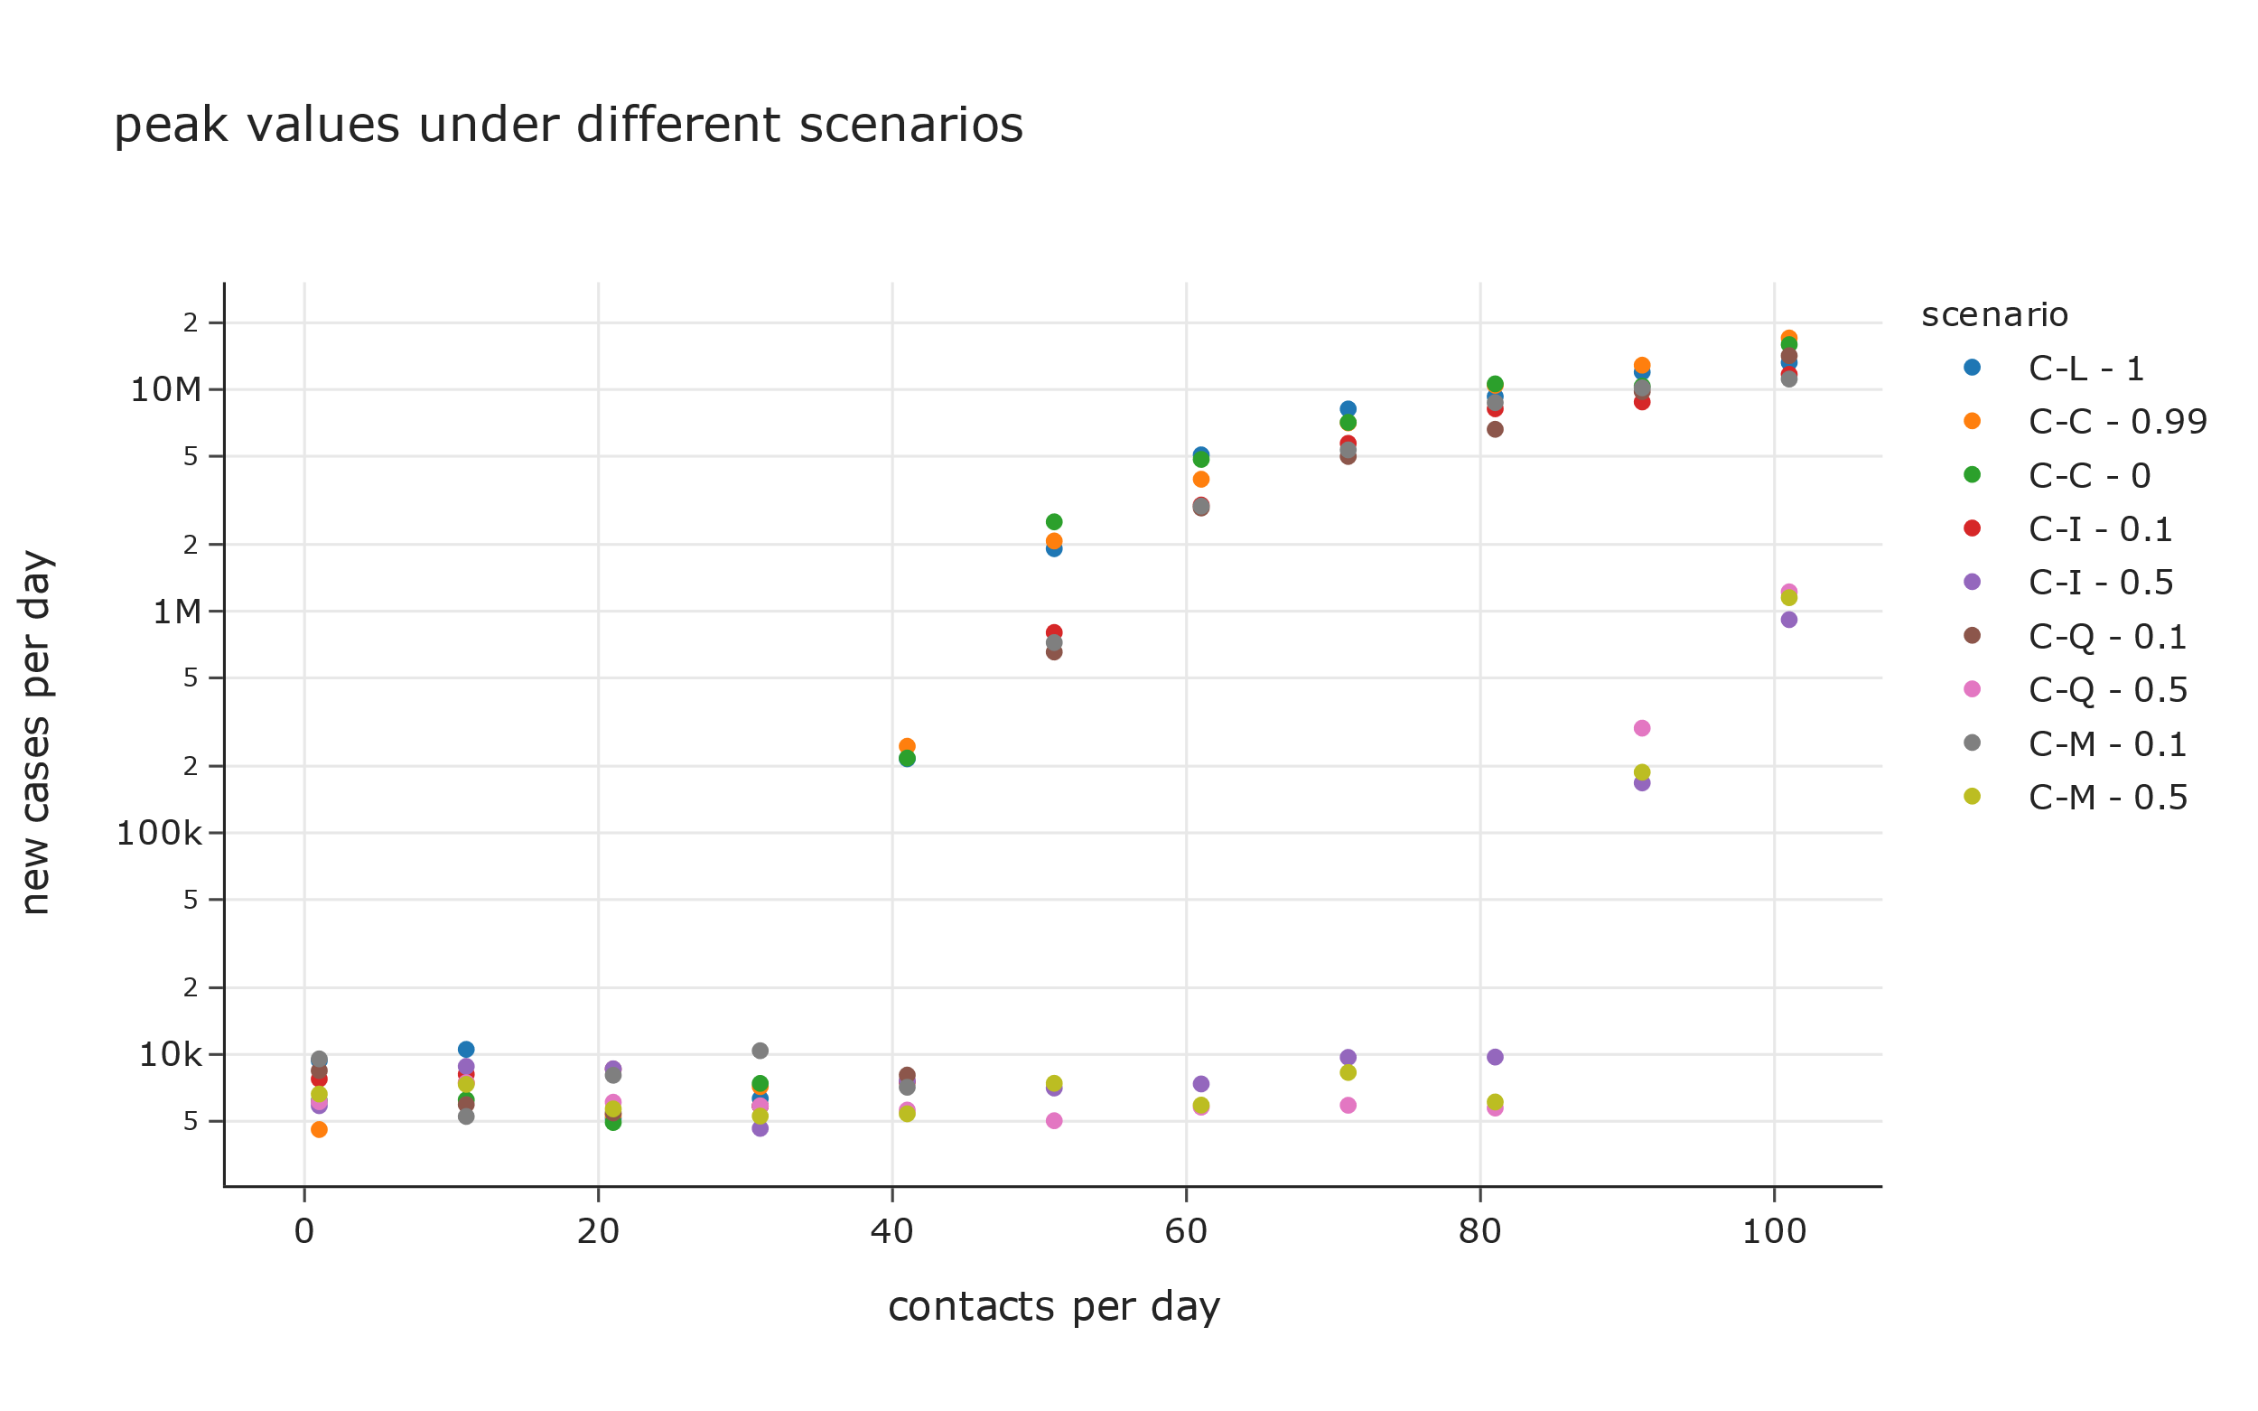
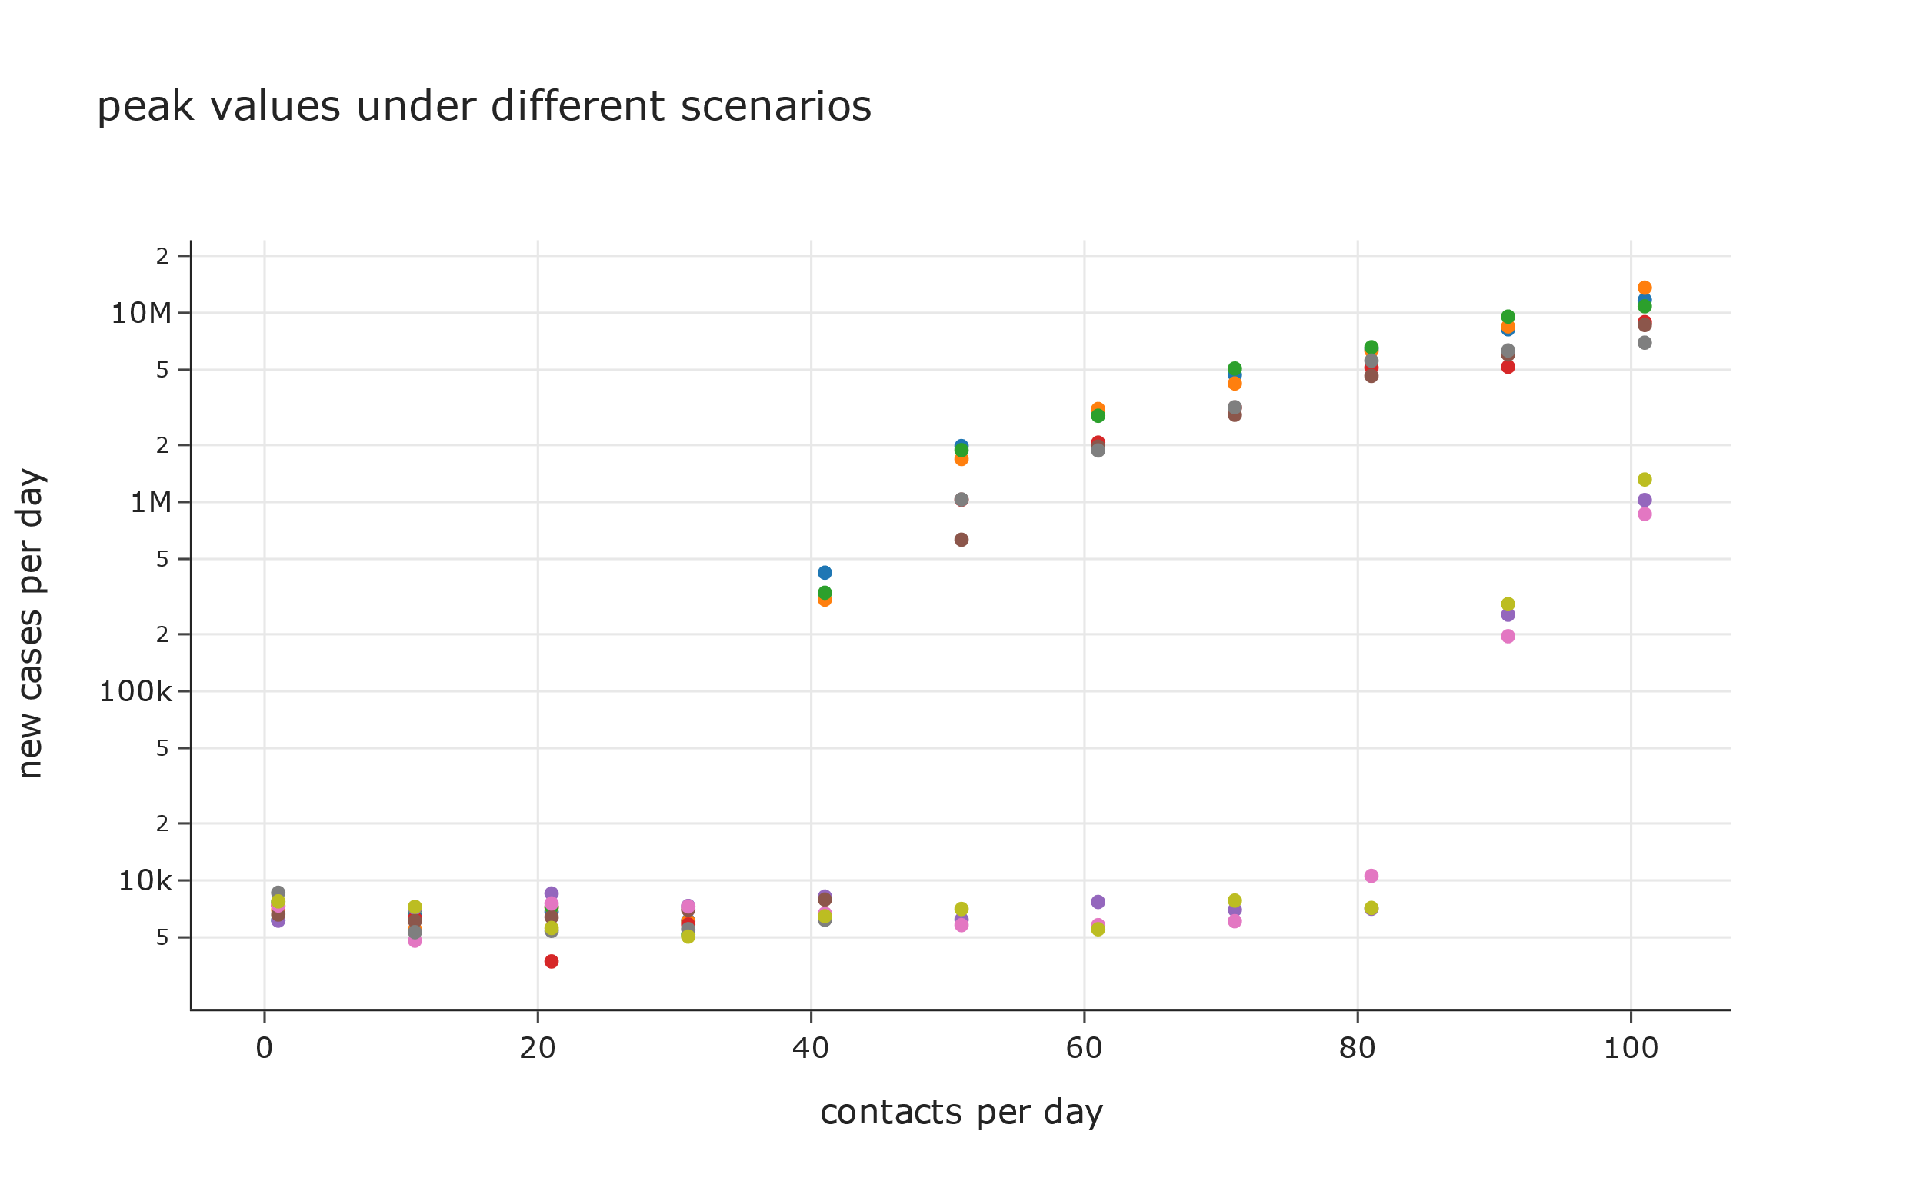
Scenarios where under-capacity of hospitals has no impact on deaths
Scenarios where under-capacity of hospitals has a multiplier effect on deaths

Slide 23
Time for peak value of new cases per day
 |  |  | 1 | 11 | 21 | 31 | 41 | 51 | 61 | 71 | 81 | 91 | 101
C | Q | 0.5 | 140 | 140 | 139 | 138 | 140 | 140 | 140 | 140 | 139 | 1,526 | 1,260
U | M | 0.5 | 140 | 139 | 138 | 140 | 140 | 140 | 139 | 140 | 140 | 1,780 | 1,150
C | I | 0.5 | 135 | 140 | 139 | 138 | 140 | 140 | 138 | 140 | 138 | 1,688 | 1,100
U | Q | 0.5 | 139 | 138 | 134 | 140 | 140 | 136 | 138 | 140 | 140 | 1,682 | 1,096
C | M | 0.5 | 139 | 140 | 139 | 140 | 140 | 140 | 140 | 140 | 140 | 1,524 | 1,086
U | I | 0.5 | 140 | 140 | 140 | 139 | 140 | 140 | 137 | 140 | 140 | 1,668 | 977
U | M | 0.1 | 140 | 140 | 138 | 140 | 139 | 1,108 | 671 | 541 | 433 | 405 | 395
U | I | 0.1 | 140 | 139 | 137 | 140 | 136 | 1,010 | 608 | 500 | 425 | 427 | 392
C | M | 0.1 | 140 | 140 | 139 | 140 | 140 | 1,315 | 737 | 528 | 475 | 388 | 378
C | I | 0.1 | 140 | 140 | 140 | 140 | 140 | 1,096 | 747 | 529 | 432 | 424 | 370
C | Q | 0.1 | 140 | 140 | 140 | 140 | 140 | 1,084 | 690 | 534 | 448 | 424 | 370
U | Q | 0.1 | 138 | 138 | 136 | 139 | 139 | 970 | 627 | 520 | 493 | 440 | 369
U | L | 1 | 136 | 139 | 140 | 140 | 1,752 | 724 | 572 | 443 | 385 | 402 | 359
U | C | 0 | 138 | 136 | 140 | 140 | 1,680 | 712 | 588 | 449 | 427 | 371 | 353
U | C | 0.99 | 140 | 139 | 139 | 140 | 1,667 | 751 | 526 | 488 | 400 | 369 | 347
C | L | 1 | 140 | 140 | 140 | 139 | 1,712 | 772 | 597 | 454 | 432 | 347 | 342
C | C | 0.99 | 139 | 137 | 136 | 140 | 1,572 | 797 | 638 | 469 | 393 | 369 | 335
C | C | 0 | 140 | 138 | 140 | 140 | 1,783 | 715 | 601 | 477 | 405 | 390 | 334

Slide 24
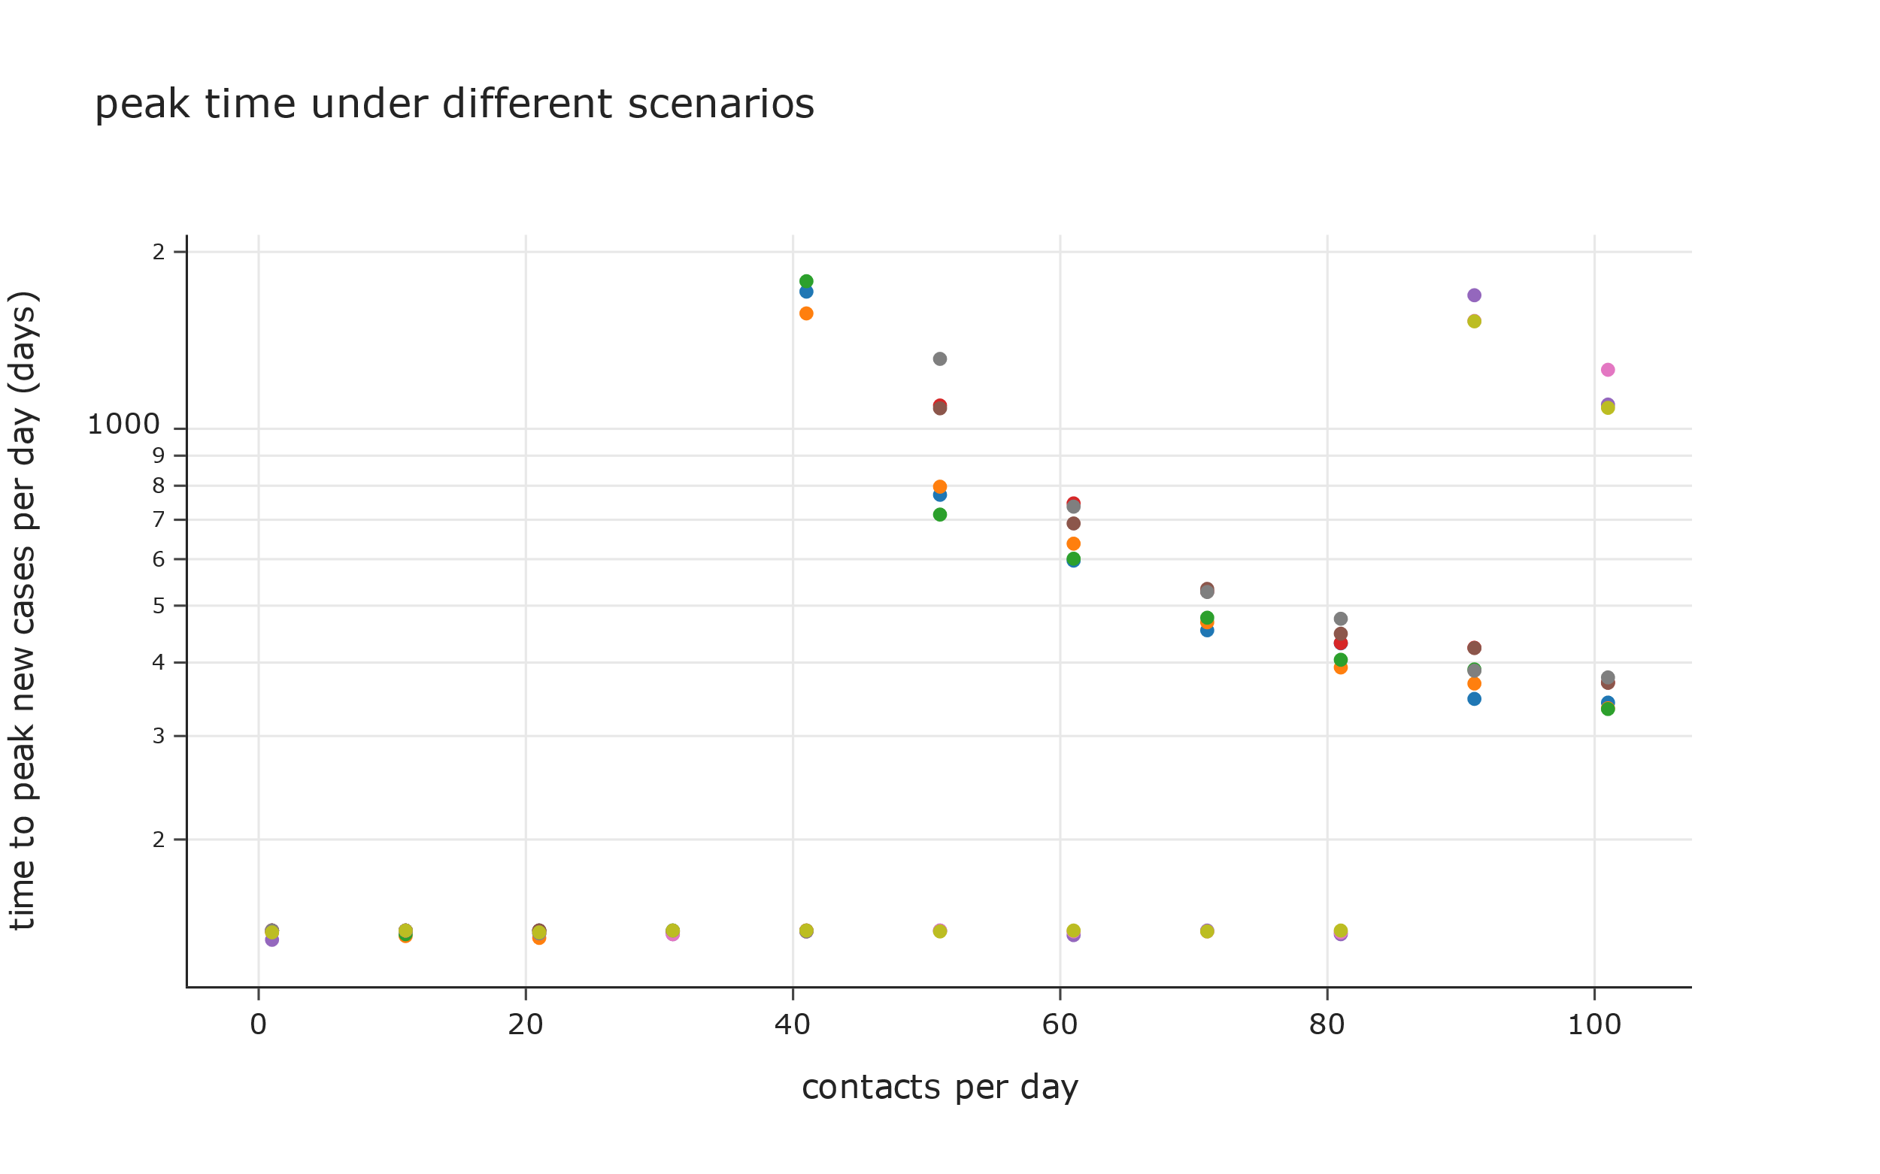
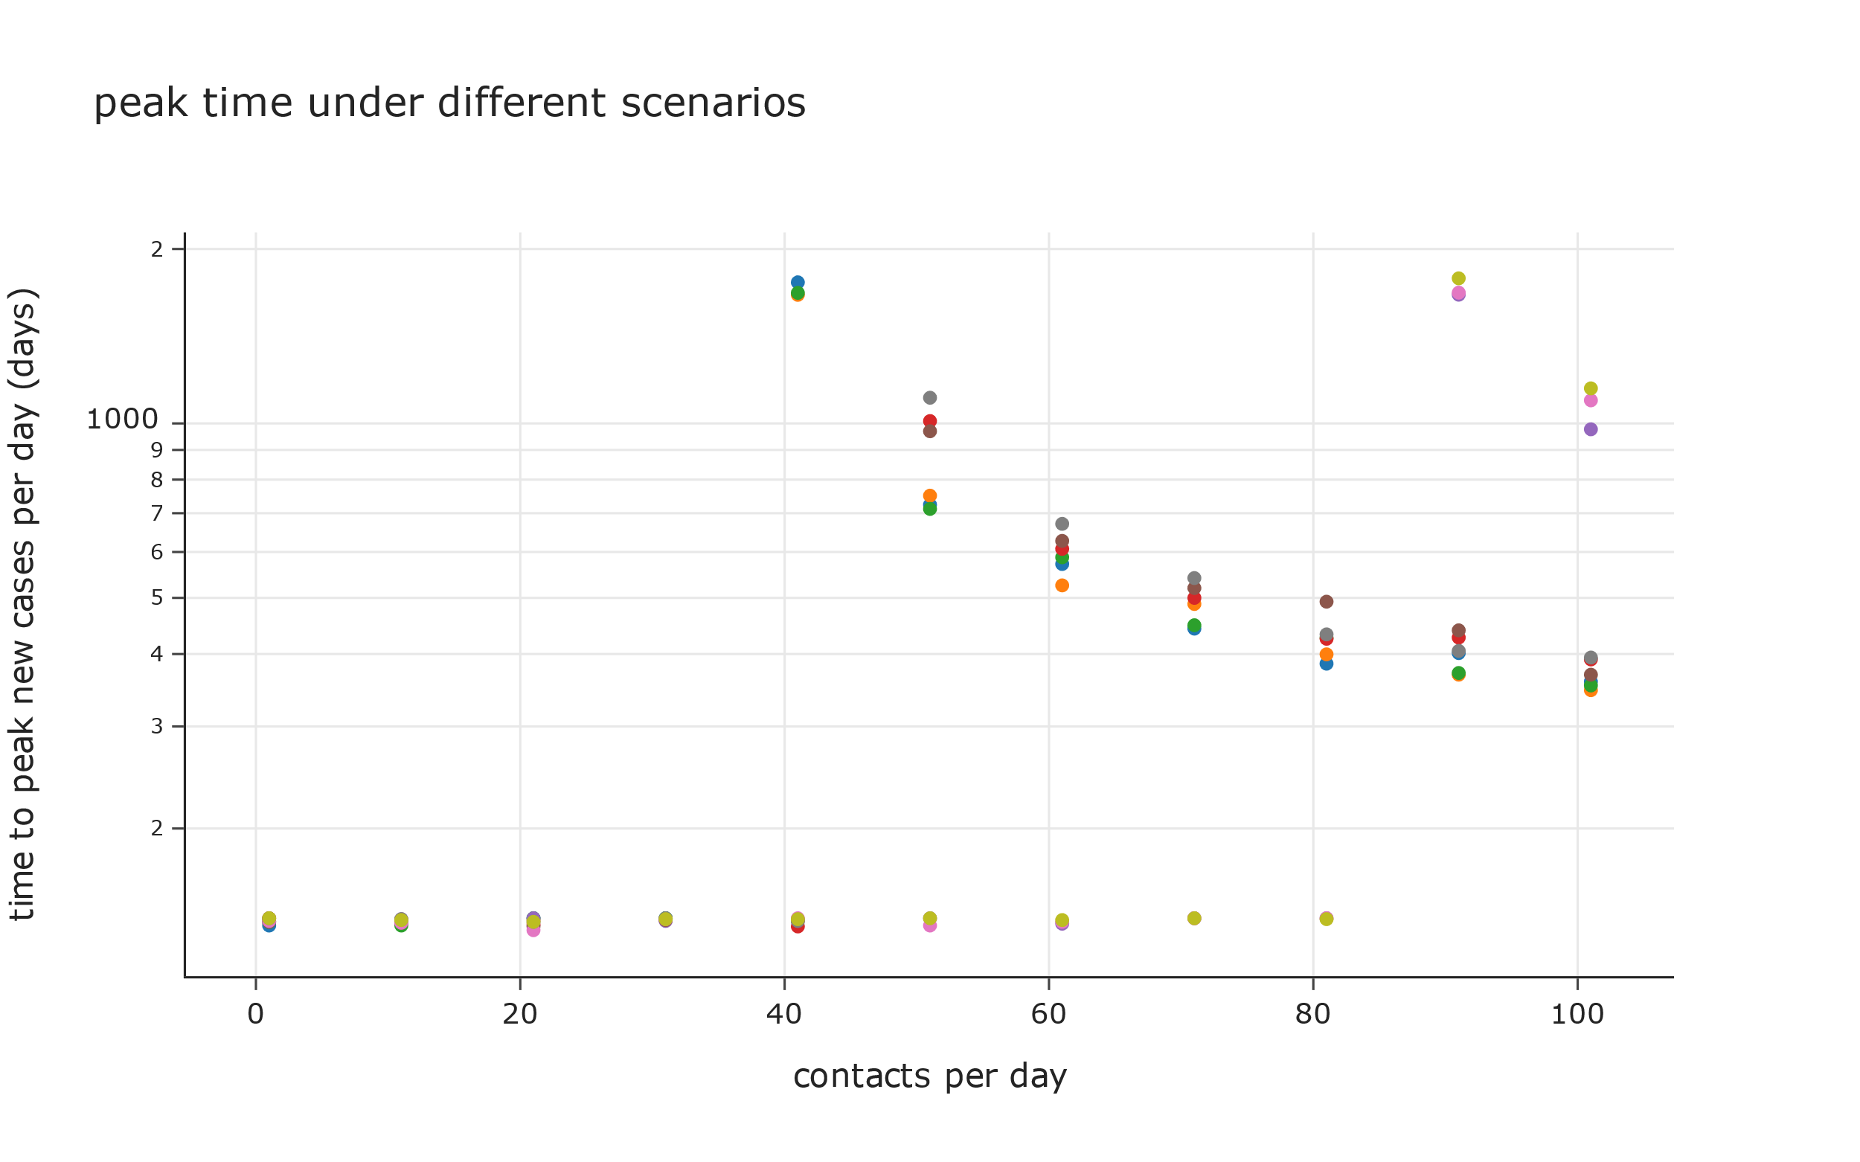
Scenarios where under-capacity of hospitals has no impact on deaths
Scenarios where under-capacity of hospitals has a multiplier effect on deaths

Slide 25
Duration of the Pandemic

Slide 26
Peak value of total cases
 |  |  | 1 | 11 | 21 | 31 | 41 | 51 | 61 | 71 | 81 | 91 | 101
C | C | 0 | 182,827 | 252,181 | 326,088 | 911,066 | 133,385,946 | 670,273,496 | 878,916,492 | 993,942,049 | 1,128,645,200 | 1,181,475,011 | 1,266,312,904
C | C | 0.99 | 156,640 | 270,340 | 310,263 | 880,215 | 160,587,469 | 661,276,998 | 827,973,814 | 1,003,066,116 | 1,102,397,507 | 1,196,769,889 | 1,261,686,290
C | L | 1 | 274,059 | 368,793 | 291,457 | 846,198 | 118,911,979 | 605,678,164 | 899,593,843 | 1,031,898,368 | 1,124,581,073 | 1,168,309,711 | 1,229,157,712
C | Q | 0.1 | 239,058 | 213,316 | 256,119 | 532,695 | 4,549,166 | 401,958,125 | 686,428,352 | 873,240,784 | 1,013,623,486 | 1,113,438,072 | 1,181,034,690
U | L | 1 | 215,600 | 208,845 | 418,972 | 772,467 | 145,918,083 | 606,270,739 | 744,122,793 | 897,815,352 | 1,001,937,885 | 1,085,983,804 | 1,168,036,847
C | M | 0.1 | 264,263 | 198,652 | 416,073 | 799,498 | 4,694,464 | 413,628,168 | 738,657,177 | 890,968,253 | 1,030,738,697 | 1,092,741,009 | 1,157,042,763
C | I | 0.1 | 212,479 | 282,870 | 380,797 | 516,298 | 3,774,797 | 403,334,398 | 737,871,600 | 903,025,952 | 1,027,353,326 | 1,098,530,915 | 1,152,668,386
U | Q | 0.1 | 201,306 | 245,781 | 362,771 | 761,714 | 177,587,842 | 629,125,515 | 751,525,417 | 903,065,807 | 996,162,746 | 1,093,492,336 | 1,144,207,351
U | C | 0.99 | 231,093 | 281,998 | 374,170 | 803,656 | 167,616,798 | 613,147,664 | 755,252,999 | 905,429,740 | 982,933,818 | 1,082,288,431 | 1,135,811,121
U | C | 0 | 203,953 | 230,363 | 212,236 | 495,218 | 4,979,911 | 431,826,894 | 655,721,691 | 807,468,866 | 920,562,094 | 985,094,600 | 1,080,921,026
U | M | 0.1 | 243,663 | 204,916 | 271,079 | 436,584 | 4,595,677 | 434,006,953 | 657,672,628 | 786,550,392 | 907,532,793 | 996,029,758 | 1,076,567,873
U | I | 0.5 | 191,538 | 242,566 | 326,024 | 621,545 | 4,936,249 | 397,879,952 | 643,284,590 | 797,190,835 | 908,222,577 | 1,002,572,986 | 1,056,075,166
U | I | 0.1 | 172,860 | 207,481 | 287,501 | 293,165 | 343,684 | 371,434 | 544,050 | 988,236 | 2,974,156 | 113,331,588 | 488,842,012
U | M | 0.5 | 223,142 | 204,527 | 198,380 | 200,566 | 290,775 | 381,366 | 410,609 | 925,943 | 4,078,730 | 112,646,666 | 483,824,588
C | M | 0.5 | 194,539 | 225,986 | 218,202 | 214,923 | 255,216 | 453,549 | 462,676 | 933,725 | 2,765,407 | 133,595,996 | 474,121,778
U | Q | 0.5 | 213,903 | 175,370 | 251,125 | 252,731 | 297,054 | 329,060 | 468,856 | 774,639 | 3,439,014 | 112,831,102 | 449,590,650
C | Q | 0.5 | 162,594 | 228,535 | 205,740 | 221,306 | 262,082 | 299,011 | 464,914 | 652,939 | 2,303,176 | 143,739,185 | 435,516,369
C | I | 0.5 | 200,592 | 243,243 | 257,062 | 193,648 | 338,748 | 379,184 | 523,347 | 1,086,077 | 3,699,910 | 107,911,754 | 420,983,709

Slide 27
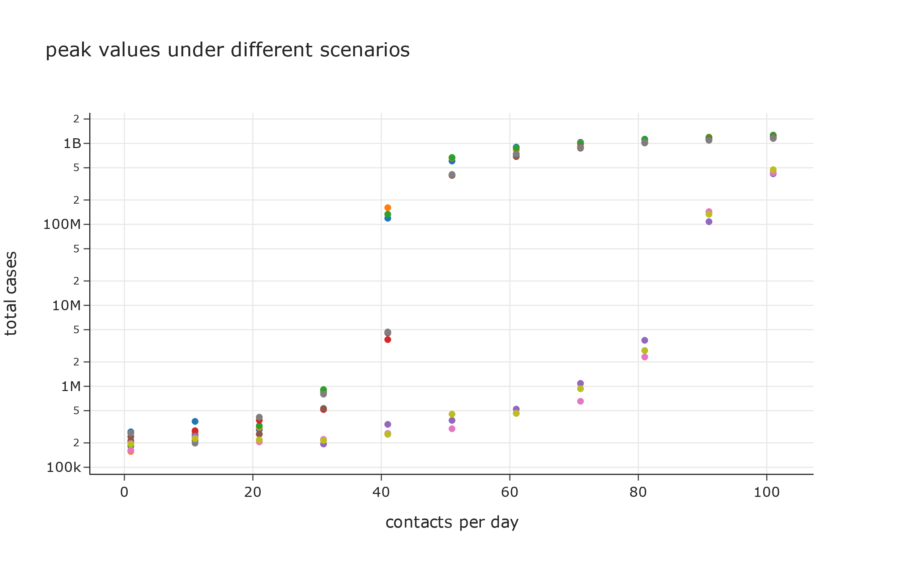
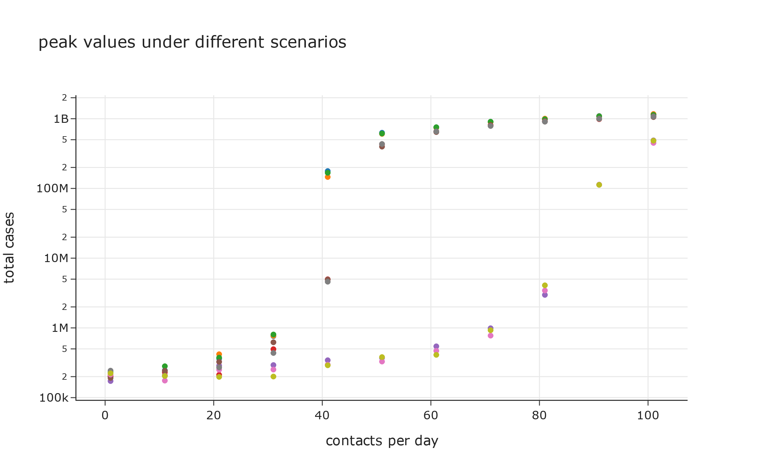
Scenarios where under-capacity of hospitals has no impact on deaths
Scenarios where under-capacity of hospitals has a multiplier effect on deaths

Slide 28
Time for peak value of total cases
 |  |  | 1 | 11 | 21 | 31 | 41 | 51 | 61 | 71 | 81 | 91 | 101
U | C | 0.99 | 1,064 | 1,485 | 1,825 | 1,825 | 1,825 | 1,825 | 1,825 | 1,825 | 1,825 | 1,825 | 1,825
U | L | 1 | 1,065 | 1,501 | 1,825 | 1,825 | 1,825 | 1,825 | 1,825 | 1,825 | 1,825 | 1,825 | 1,825
U | C | 0 | 1,032 | 1,390 | 1,825 | 1,825 | 1,825 | 1,825 | 1,825 | 1,825 | 1,825 | 1,825 | 1,825
U | Q | 0.1 | 1,064 | 1,511 | 1,825 | 1,825 | 1,825 | 1,825 | 1,825 | 1,825 | 1,825 | 1,825 | 1,825
U | M | 0.1 | 1,032 | 1,385 | 1,825 | 1,825 | 1,825 | 1,825 | 1,825 | 1,825 | 1,825 | 1,825 | 1,825
U | I | 0.5 | 1,019 | 1,390 | 1,825 | 1,825 | 1,825 | 1,825 | 1,825 | 1,825 | 1,825 | 1,825 | 1,825
C | Q | 0.5 | 898 | 1,051 | 1,227 | 1,473 | 1,825 | 1,825 | 1,825 | 1,825 | 1,825 | 1,825 | 1,825
U | Q | 0.5 | 904 | 1,040 | 1,233 | 1,473 | 1,825 | 1,825 | 1,825 | 1,825 | 1,825 | 1,825 | 1,825
U | I | 0.1 | 901 | 1,048 | 1,215 | 1,463 | 1,822 | 1,825 | 1,825 | 1,825 | 1,825 | 1,825 | 1,825
C | M | 0.5 | 904 | 1,050 | 1,228 | 1,481 | 1,806 | 1,825 | 1,825 | 1,825 | 1,825 | 1,825 | 1,825
U | M | 0.5 | 912 | 1,048 | 1,221 | 1,468 | 1,800 | 1,825 | 1,825 | 1,825 | 1,825 | 1,825 | 1,825
C | I | 0.5 | 899 | 1,052 | 1,242 | 1,478 | 1,798 | 1,825 | 1,825 | 1,825 | 1,825 | 1,825 | 1,825
C | M | 0.1 | 1,011 | 1,382 | 1,825 | 1,825 | 1,825 | 1,825 | 1,825 | 1,825 | 1,825 | 1,825 | 1,716
C | I | 0.1 | 1,036 | 1,374 | 1,825 | 1,825 | 1,825 | 1,825 | 1,825 | 1,825 | 1,825 | 1,825 | 1,712
C | Q | 0.1 | 1,041 | 1,387 | 1,825 | 1,825 | 1,825 | 1,825 | 1,825 | 1,825 | 1,825 | 1,824 | 1,606
C | L | 1 | 1,056 | 1,499 | 1,825 | 1,825 | 1,825 | 1,825 | 1,825 | 1,825 | 1,785 | 1,645 | 1,503
C | C | 0.99 | 1,056 | 1,483 | 1,825 | 1,825 | 1,825 | 1,825 | 1,825 | 1,825 | 1,825 | 1,579 | 1,371
C | C | 0 | 1,057 | 1,509 | 1,825 | 1,825 | 1,825 | 1,825 | 1,825 | 1,825 | 1,763 | 1,621 | 1,347

Slide 29
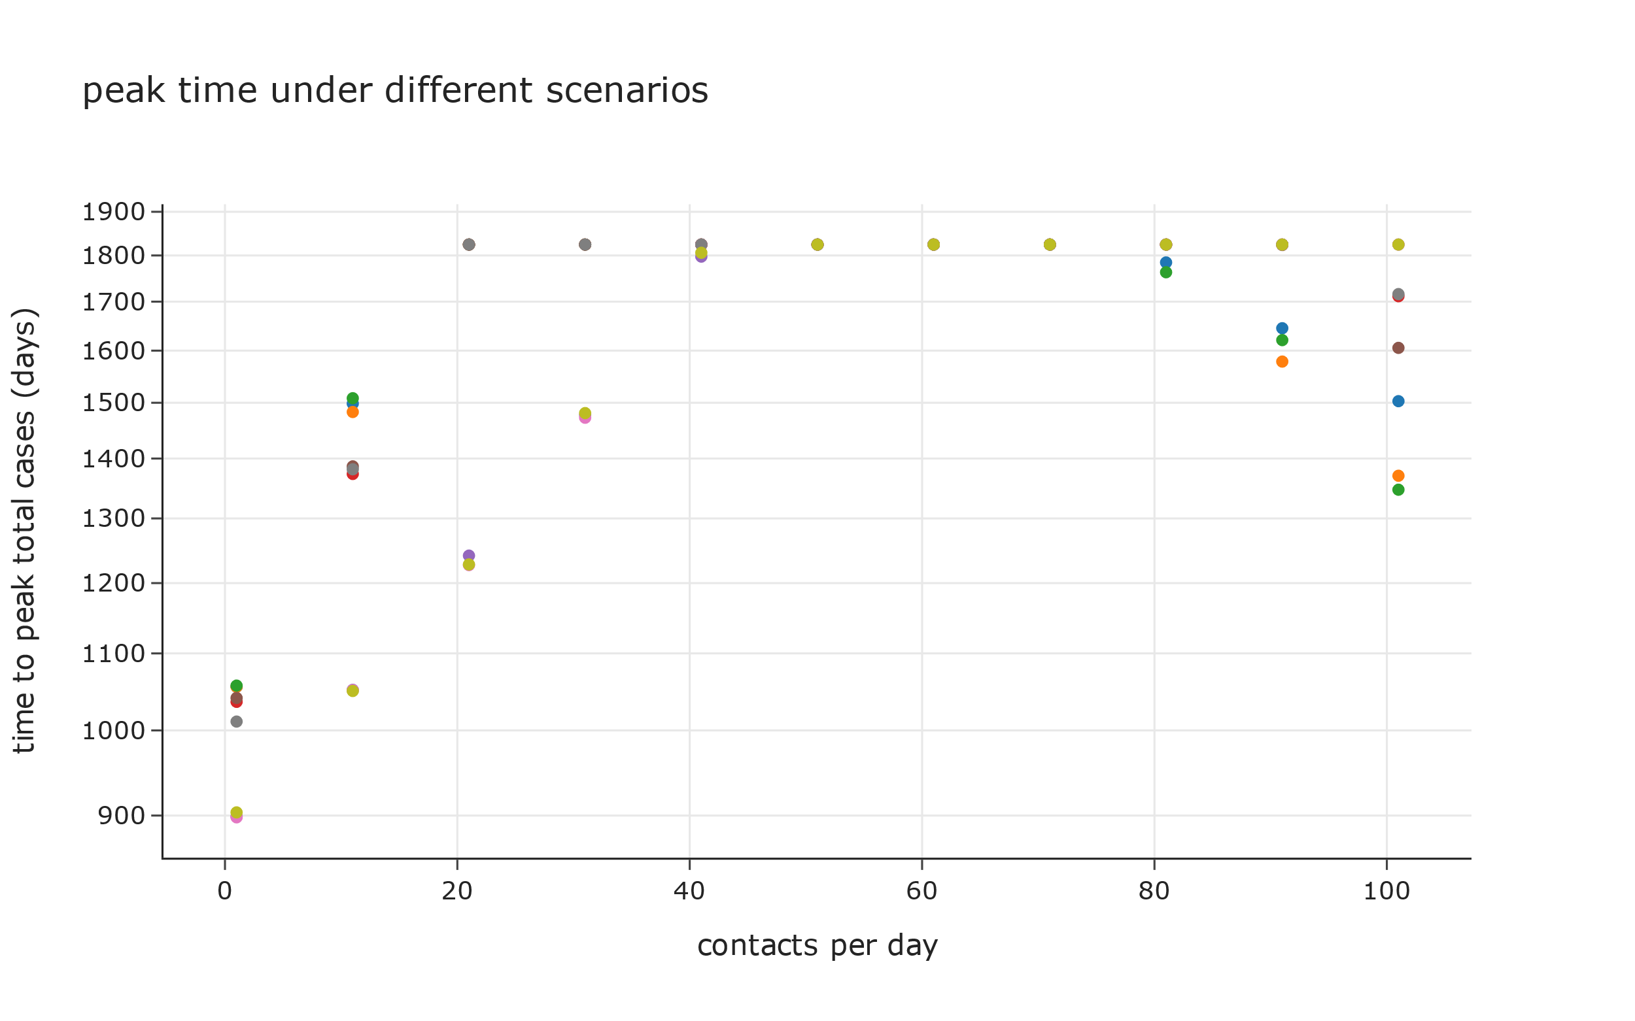
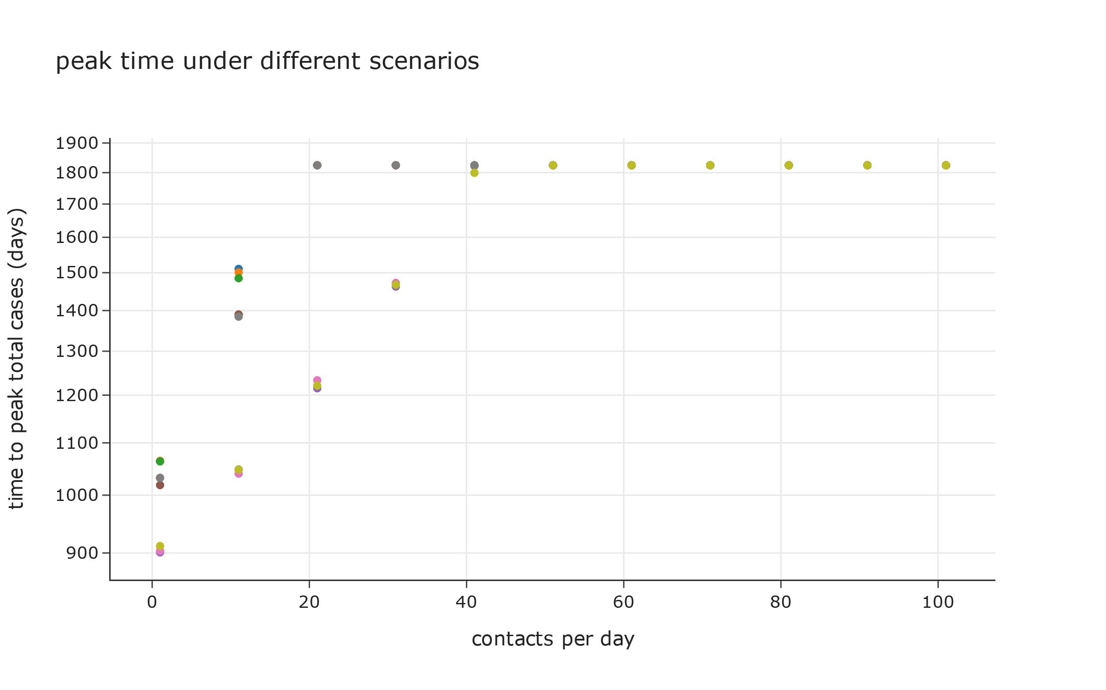
Scenarios where under-capacity of hospitals has no impact on deaths
Scenarios where under-capacity of hospitals has a multiplier effect on deaths

Slide 30
Impact of the Pandemic

Slide 31
Peak value of total deaths
 |  |  | 1 | 11 | 21 | 31 | 41 | 51 | 61 | 71 | 81 | 91 | 101
U | L | 1 | 8,688 | 8,416 | 16,884 | 31,128 | 5,688,009 | 32,941,624 | 105,046,978 | 166,512,371 | 228,688,979 | 270,753,710 | 307,283,280
U | Q | 0.1 | 8,112 | 9,904 | 14,619 | 30,695 | 6,881,424 | 49,740,047 | 95,280,957 | 179,970,804 | 231,174,953 | 273,971,815 | 299,621,227
U | C | 0.99 | 9,313 | 11,364 | 15,078 | 32,384 | 6,542,059 | 38,034,420 | 105,725,080 | 175,911,858 | 221,640,858 | 271,489,500 | 292,777,912
U | M | 0.1 | 9,819 | 8,258 | 10,924 | 17,593 | 184,116 | 17,474,692 | 53,503,898 | 110,022,522 | 196,353,557 | 214,645,091 | 266,486,171
U | C | 0 | 8,219 | 9,283 | 8,553 | 19,956 | 198,663 | 17,386,145 | 53,548,943 | 109,240,322 | 172,136,281 | 209,944,909 | 264,895,060
U | I | 0.5 | 7,719 | 9,775 | 13,138 | 25,047 | 197,440 | 15,978,231 | 55,836,454 | 103,588,996 | 177,377,514 | 221,567,844 | 258,778,377
C | C | 0 | 7,368 | 10,162 | 13,141 | 36,713 | 5,214,236 | 27,010,581 | 35,418,481 | 40,053,769 | 45,482,022 | 47,610,952 | 51,029,740
C | C | 0.99 | 6,312 | 10,894 | 12,503 | 35,470 | 6,316,875 | 26,647,973 | 33,365,598 | 40,421,450 | 44,424,295 | 48,227,303 | 50,843,297
C | L | 1 | 11,044 | 14,862 | 11,745 | 34,099 | 4,644,554 | 24,406,997 | 36,251,735 | 41,583,329 | 45,318,246 | 47,080,418 | 49,532,464
C | Q | 0.1 | 9,634 | 8,596 | 10,321 | 21,467 | 182,054 | 16,118,166 | 27,661,553 | 35,189,762 | 40,846,889 | 44,869,207 | 47,593,208
C | M | 0.1 | 10,649 | 8,005 | 16,767 | 32,218 | 188,136 | 16,538,954 | 29,766,322 | 35,904,142 | 41,536,596 | 44,035,159 | 46,626,384
C | I | 0.1 | 8,563 | 11,399 | 15,345 | 20,806 | 151,416 | 16,221,004 | 29,734,655 | 36,390,042 | 41,400,173 | 44,268,480 | 46,450,106
U | I | 0.1 | 6,966 | 8,361 | 11,586 | 11,814 | 13,850 | 14,968 | 21,924 | 39,822 | 119,376 | 4,420,613 | 19,681,143
U | M | 0.5 | 8,992 | 8,242 | 7,994 | 8,082 | 11,718 | 15,368 | 16,547 | 37,312 | 163,577 | 4,329,169 | 19,489,733
C | M | 0.5 | 7,840 | 9,107 | 8,793 | 8,661 | 10,285 | 18,277 | 18,645 | 37,627 | 110,994 | 5,269,618 | 19,093,318
U | Q | 0.5 | 8,620 | 7,067 | 10,120 | 10,185 | 11,971 | 13,260 | 18,894 | 31,216 | 138,161 | 4,422,931 | 18,098,444
C | Q | 0.5 | 6,552 | 9,210 | 8,291 | 8,918 | 10,561 | 12,050 | 18,735 | 26,312 | 92,400 | 5,590,819 | 17,513,203
C | I | 0.5 | 8,083 | 9,802 | 10,359 | 7,804 | 13,651 | 15,280 | 21,090 | 43,766 | 148,709 | 4,244,264 | 16,913,066

Slide 32
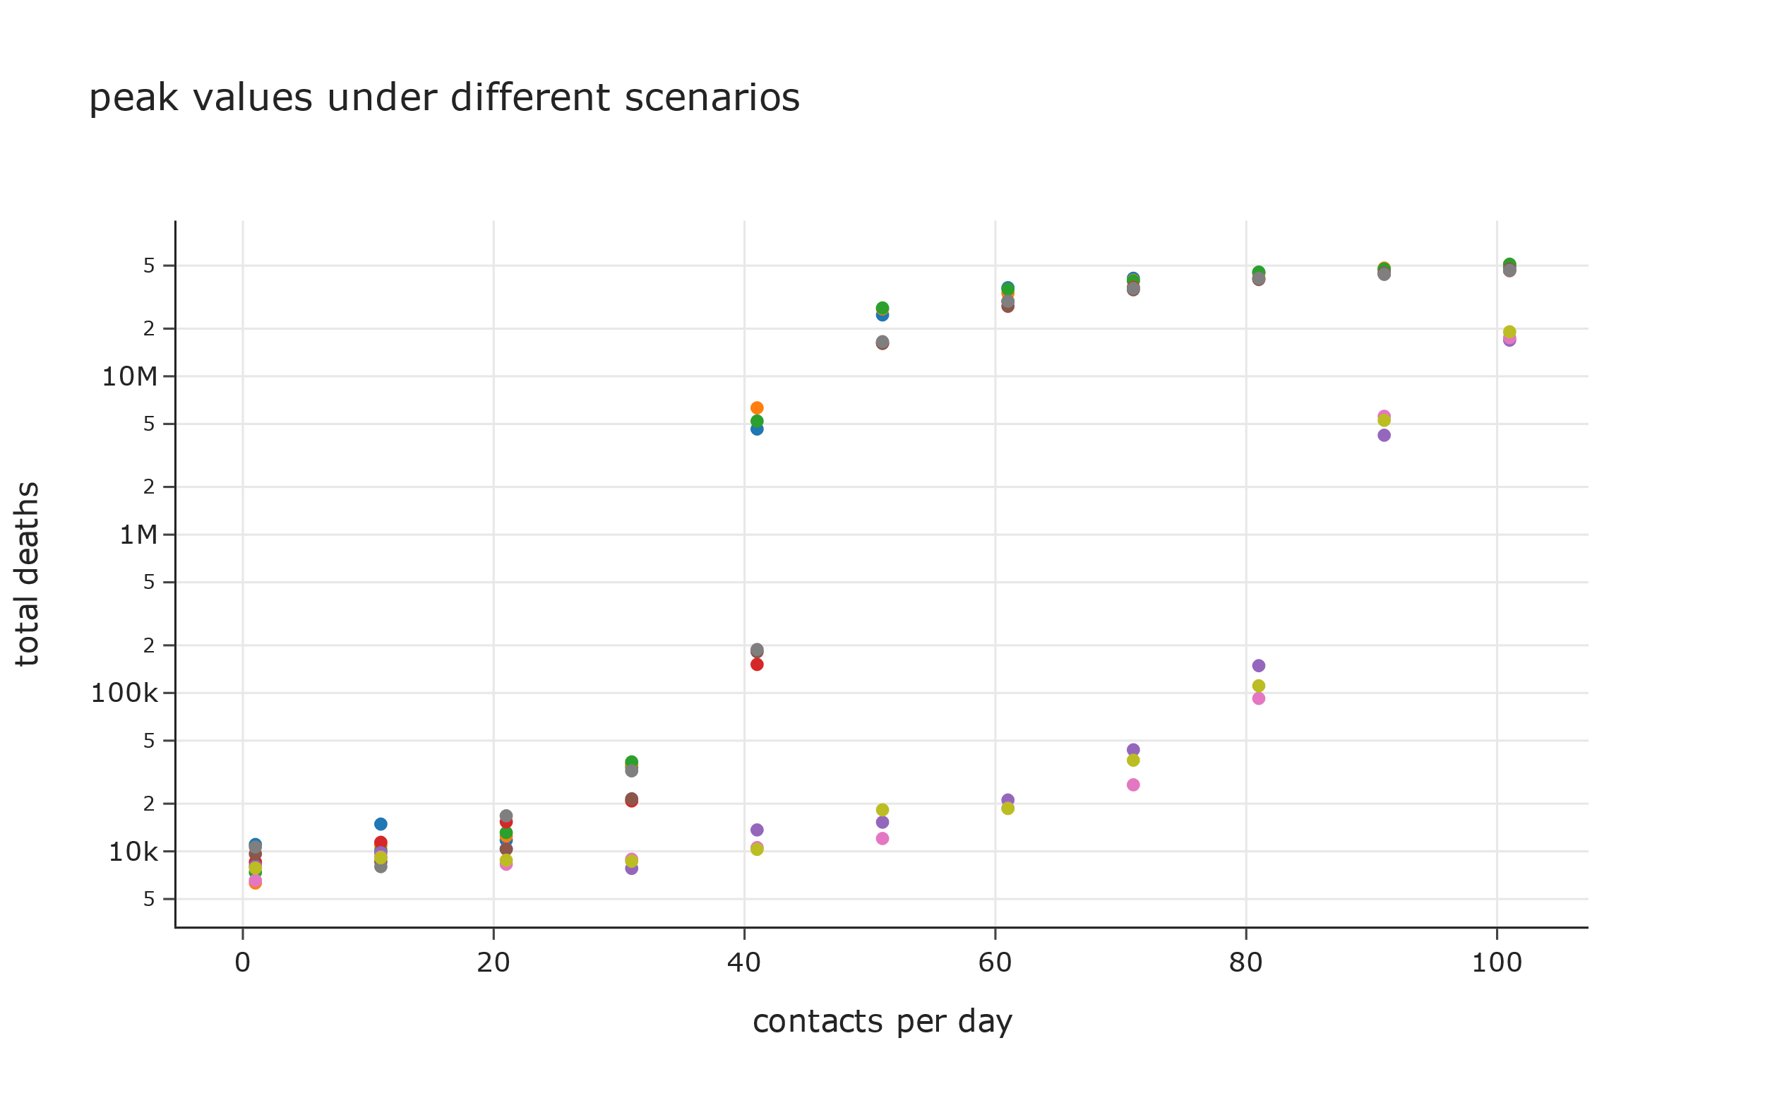
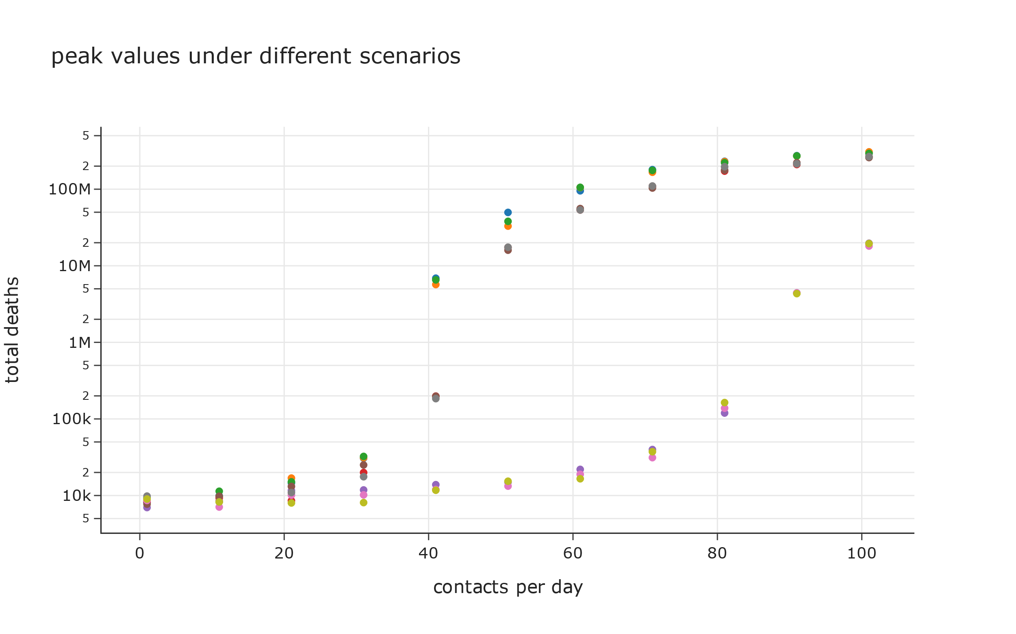
Scenarios where under-capacity of hospitals has no impact on deaths
Scenarios where under-capacity of hospitals has a multiplier effect on deaths

Slide 33
Time for peak value of total deaths
 |  |  | 1 | 11 | 21 | 31 | 41 | 51 | 61 | 71 | 81 | 91 | 101
U | C | 0.99 | 1,088 | 1,525 | 1,825 | 1,825 | 1,825 | 1,825 | 1,825 | 1,825 | 1,825 | 1,825 | 1,825
U | Q | 0.1 | 1,106 | 1,521 | 1,825 | 1,825 | 1,825 | 1,825 | 1,825 | 1,825 | 1,825 | 1,825 | 1,825
U | L | 1 | 1,090 | 1,511 | 1,825 | 1,825 | 1,825 | 1,825 | 1,825 | 1,825 | 1,825 | 1,825 | 1,825
U | C | 0 | 1,055 | 1,404 | 1,825 | 1,825 | 1,825 | 1,825 | 1,825 | 1,825 | 1,825 | 1,825 | 1,825
U | I | 0.5 | 1,066 | 1,403 | 1,825 | 1,825 | 1,825 | 1,825 | 1,825 | 1,825 | 1,825 | 1,825 | 1,825
U | M | 0.1 | 1,058 | 1,398 | 1,825 | 1,825 | 1,825 | 1,825 | 1,825 | 1,825 | 1,825 | 1,825 | 1,825
C | I | 0.5 | 954 | 1,077 | 1,260 | 1,517 | 1,825 | 1,825 | 1,825 | 1,825 | 1,825 | 1,825 | 1,825
U | M | 0.5 | 945 | 1,073 | 1,264 | 1,508 | 1,825 | 1,825 | 1,825 | 1,825 | 1,825 | 1,825 | 1,825
U | I | 0.1 | 953 | 1,073 | 1,255 | 1,501 | 1,825 | 1,825 | 1,825 | 1,825 | 1,825 | 1,825 | 1,825
C | Q | 0.5 | 951 | 1,076 | 1,242 | 1,487 | 1,825 | 1,825 | 1,825 | 1,825 | 1,825 | 1,825 | 1,825
U | Q | 0.5 | 938 | 1,085 | 1,248 | 1,482 | 1,825 | 1,825 | 1,825 | 1,825 | 1,825 | 1,825 | 1,825
C | M | 0.5 | 953 | 1,075 | 1,246 | 1,492 | 1,811 | 1,825 | 1,825 | 1,825 | 1,825 | 1,825 | 1,825
C | I | 0.1 | 1,058 | 1,414 | 1,825 | 1,825 | 1,825 | 1,825 | 1,825 | 1,825 | 1,825 | 1,825 | 1,755
C | M | 0.1 | 1,057 | 1,422 | 1,825 | 1,825 | 1,825 | 1,825 | 1,825 | 1,825 | 1,825 | 1,825 | 1,751
C | Q | 0.1 | 1,070 | 1,400 | 1,825 | 1,825 | 1,825 | 1,825 | 1,825 | 1,825 | 1,825 | 1,825 | 1,643
C | L | 1 | 1,099 | 1,539 | 1,825 | 1,825 | 1,825 | 1,825 | 1,825 | 1,825 | 1,822 | 1,686 | 1,538
C | C | 0.99 | 1,098 | 1,523 | 1,825 | 1,825 | 1,825 | 1,825 | 1,825 | 1,825 | 1,825 | 1,616 | 1,412
C | C | 0 | 1,103 | 1,519 | 1,825 | 1,825 | 1,825 | 1,825 | 1,825 | 1,825 | 1,801 | 1,663 | 1,386

Slide 34
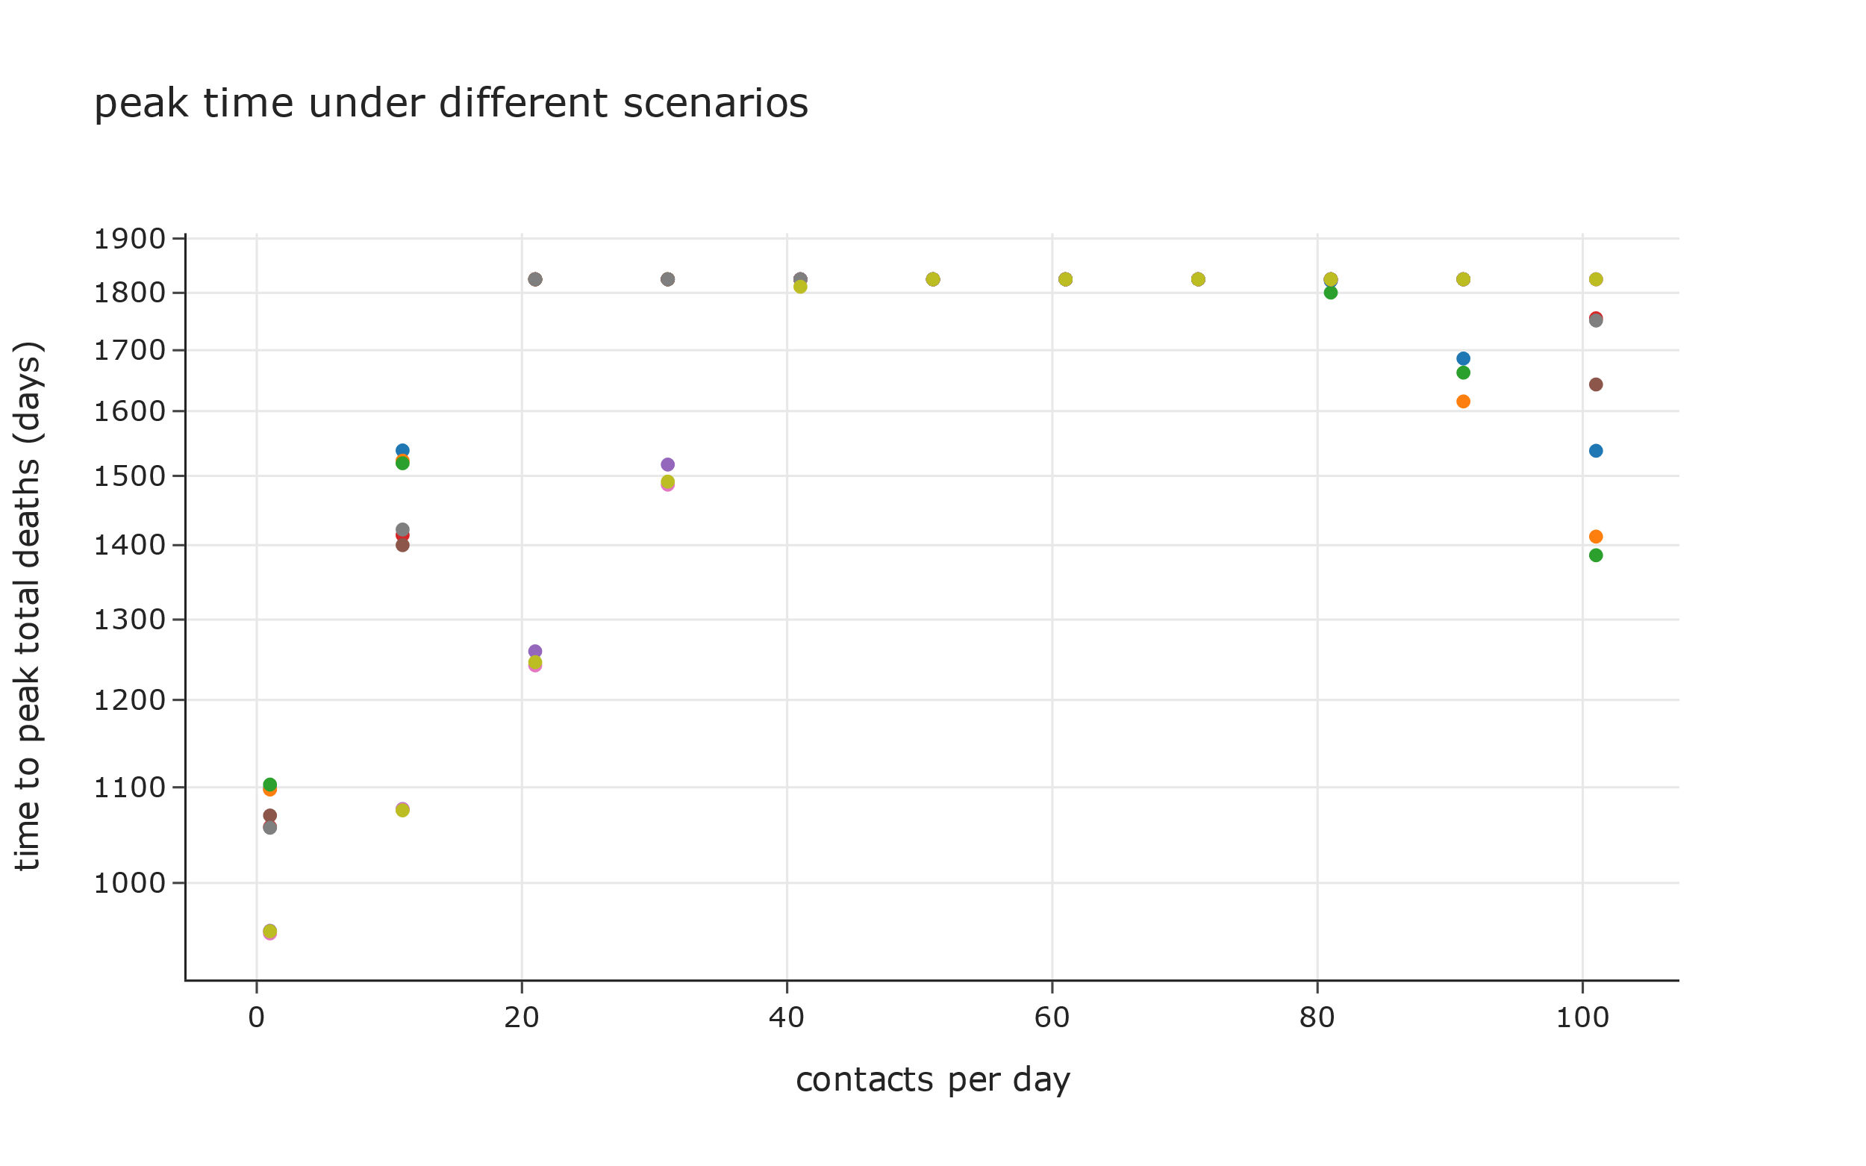
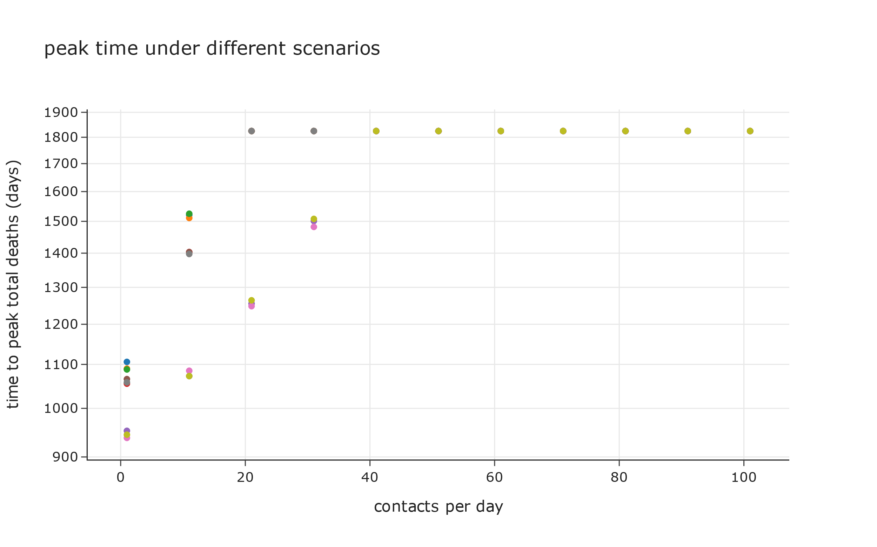
Scenarios where under-capacity of hospitals has no impact on deaths
Scenarios where under-capacity of hospitals has a multiplier effect on deaths

Slide 35
Burden of the Disease

Slide 36
Peak value of active cases
 |  |  | 1 | 11 | 21 | 31 | 41 | 51 | 61 | 71 | 81 | 91 | 101
C | C | 0 | 68,132 | 74,355 | 65,513 | 83,297 | 4,087,094 | 48,297,886 | 84,735,716 | 125,687,857 | 186,745,865 | 191,021,082 | 281,572,388
C | C | 0.99 | 55,038 | 80,735 | 62,486 | 84,078 | 4,366,700 | 38,108,827 | 72,926,277 | 124,829,342 | 167,515,223 | 217,337,706 | 280,229,977
C | Q | 0.1 | 92,801 | 65,467 | 59,275 | 72,992 | 99,055 | 12,145,338 | 50,561,954 | 85,102,529 | 117,651,634 | 173,287,009 | 232,749,536
C | L | 1 | 102,430 | 113,636 | 59,942 | 77,579 | 3,987,415 | 33,605,983 | 89,652,530 | 141,374,132 | 172,743,866 | 200,297,727 | 229,319,740
C | I | 0.1 | 79,466 | 90,380 | 94,092 | 74,423 | 95,417 | 14,619,420 | 54,765,217 | 93,635,323 | 139,139,087 | 155,037,886 | 200,643,527
C | M | 0.1 | 101,583 | 60,149 | 99,809 | 111,230 | 89,895 | 13,606,096 | 54,262,890 | 91,252,717 | 147,032,170 | 175,072,016 | 198,476,754
U | L | 1 | 79,243 | 61,092 | 86,435 | 72,459 | 5,647,374 | 28,163,900 | 45,454,621 | 58,987,623 | 84,202,778 | 113,447,544 | 165,438,320
U | Q | 0.1 | 75,363 | 72,614 | 74,496 | 78,162 | 7,927,288 | 31,963,429 | 42,560,046 | 62,440,805 | 87,668,194 | 111,594,049 | 161,569,982
U | C | 0.99 | 87,686 | 86,258 | 80,104 | 65,881 | 6,243,607 | 29,950,124 | 42,743,060 | 66,819,323 | 86,220,144 | 126,508,042 | 140,545,150
U | C | 0 | 76,999 | 72,196 | 47,965 | 68,692 | 79,667 | 18,971,307 | 31,425,843 | 45,671,270 | 66,052,084 | 66,813,225 | 118,913,011
U | I | 0.5 | 72,541 | 75,874 | 76,773 | 83,920 | 94,788 | 11,242,459 | 31,855,942 | 42,016,799 | 63,231,542 | 76,593,720 | 115,519,116
U | M | 0.1 | 94,079 | 62,374 | 62,891 | 62,785 | 90,820 | 18,626,468 | 29,149,708 | 45,282,994 | 71,121,839 | 81,294,461 | 94,378,513
U | M | 0.5 | 88,710 | 76,543 | 65,604 | 57,892 | 76,401 | 83,064 | 63,112 | 89,395 | 103,918 | 5,217,507 | 23,528,925
C | Q | 0.5 | 66,756 | 86,706 | 69,089 | 65,482 | 65,456 | 60,551 | 73,141 | 71,528 | 71,733 | 5,265,428 | 21,005,222
C | M | 0.5 | 76,497 | 82,924 | 73,305 | 63,046 | 63,277 | 91,631 | 67,869 | 96,546 | 74,131 | 3,330,809 | 20,458,830
U | I | 0.1 | 68,828 | 79,709 | 99,015 | 87,617 | 90,237 | 71,677 | 94,274 | 80,403 | 81,723 | 4,448,207 | 18,498,525
C | I | 0.5 | 78,816 | 92,558 | 90,646 | 55,487 | 89,253 | 77,699 | 83,824 | 111,970 | 133,371 | 2,986,986 | 17,298,524
U | Q | 0.5 | 85,695 | 62,389 | 86,420 | 75,763 | 77,951 | 75,298 | 77,178 | 74,100 | 126,929 | 3,522,243 | 16,027,329

Slide 37
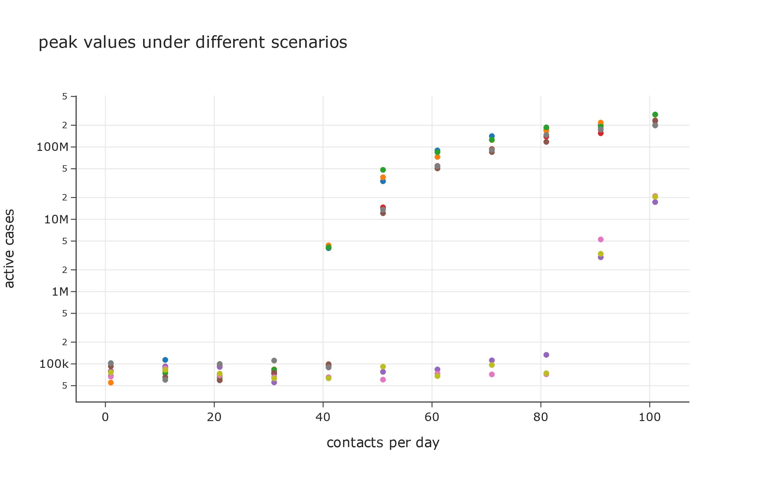
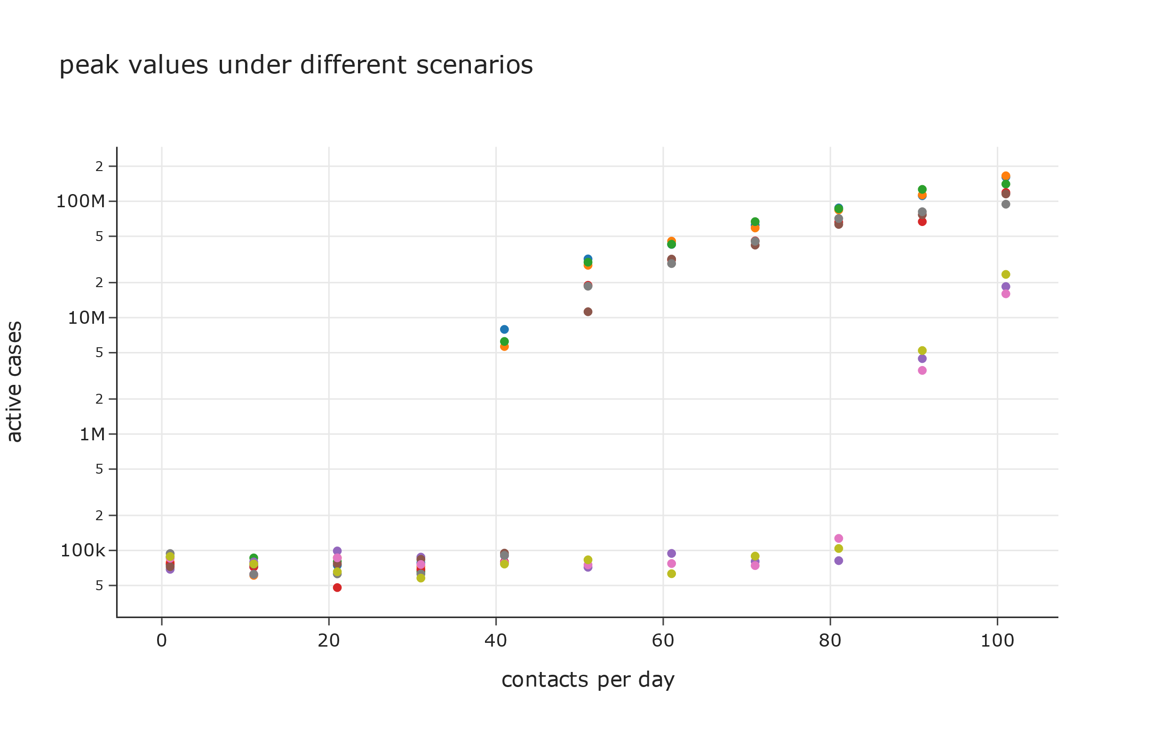
Scenarios where under-capacity of hospitals has no impact on deaths
Scenarios where under-capacity of hospitals has a multiplier effect on deaths

Slide 38
Time for peak value of active cases
 |  |  | 1 | 11 | 21 | 31 | 41 | 51 | 61 | 71 | 81 | 91 | 101
C | Q | 0.5 | 144 | 144 | 144 | 145 | 145 | 148 | 146 | 150 | 168 | 1,806 | 1,264
U | M | 0.5 | 144 | 144 | 144 | 145 | 145 | 146 | 148 | 152 | 248 | 1,825 | 1,153
C | I | 0.5 | 143 | 145 | 145 | 144 | 145 | 146 | 148 | 150 | 210 | 1,690 | 1,138
C | M | 0.5 | 144 | 144 | 143 | 145 | 146 | 147 | 147 | 148 | 222 | 1,528 | 1,107
U | Q | 0.5 | 144 | 143 | 143 | 145 | 146 | 144 | 148 | 151 | 155 | 1,686 | 1,097
U | I | 0.1 | 144 | 144 | 144 | 144 | 146 | 147 | 146 | 152 | 154 | 1,682 | 1,004
U | M | 0.1 | 144 | 144 | 145 | 148 | 317 | 1,112 | 675 | 543 | 452 | 438 | 420
C | M | 0.1 | 145 | 145 | 146 | 149 | 151 | 1,319 | 744 | 553 | 491 | 406 | 400
C | Q | 0.1 | 145 | 145 | 146 | 147 | 220 | 1,103 | 707 | 556 | 480 | 439 | 397
U | C | 0 | 144 | 144 | 144 | 146 | 152 | 1,056 | 648 | 516 | 437 | 443 | 394
U | I | 0.5 | 143 | 144 | 145 | 146 | 460 | 1,097 | 631 | 522 | 499 | 445 | 392
C | I | 0.1 | 145 | 145 | 146 | 147 | 265 | 1,098 | 748 | 570 | 469 | 428 | 384
C | L | 1 | 144 | 145 | 147 | 148 | 1,723 | 777 | 620 | 470 | 451 | 376 | 372
U | Q | 0.1 | 143 | 145 | 146 | 150 | 1,771 | 728 | 573 | 496 | 419 | 404 | 363
U | C | 0.99 | 144 | 145 | 147 | 149 | 1,685 | 724 | 590 | 451 | 430 | 383 | 358
C | C | 0 | 144 | 144 | 146 | 148 | 1,793 | 745 | 639 | 513 | 416 | 398 | 352
U | L | 1 | 144 | 145 | 146 | 150 | 1,703 | 754 | 533 | 501 | 430 | 393 | 351
C | C | 0.99 | 143 | 143 | 146 | 147 | 1,484 | 784 | 646 | 483 | 414 | 390 | 350

Slide 39
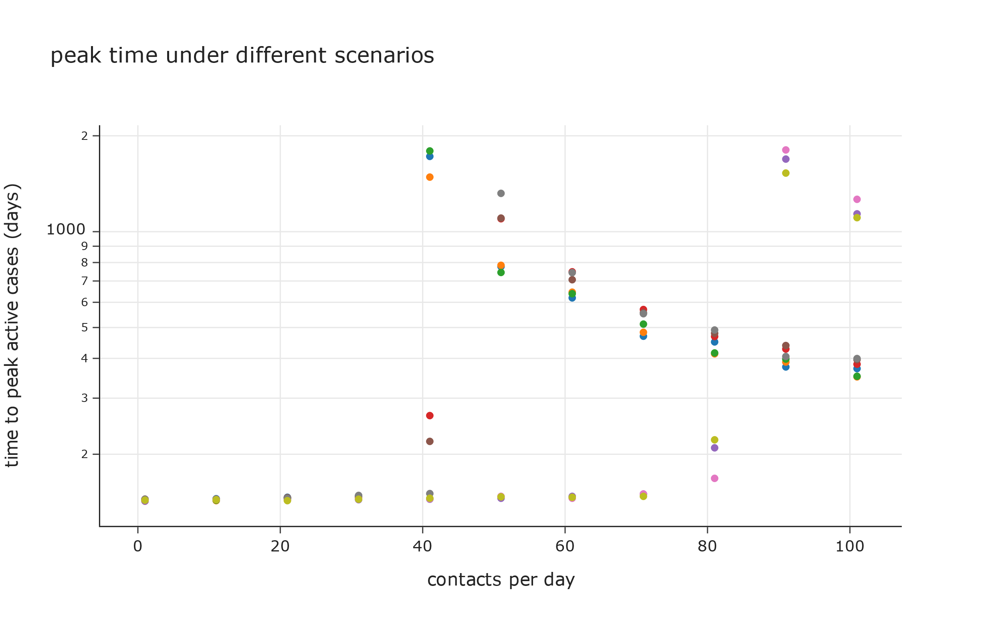
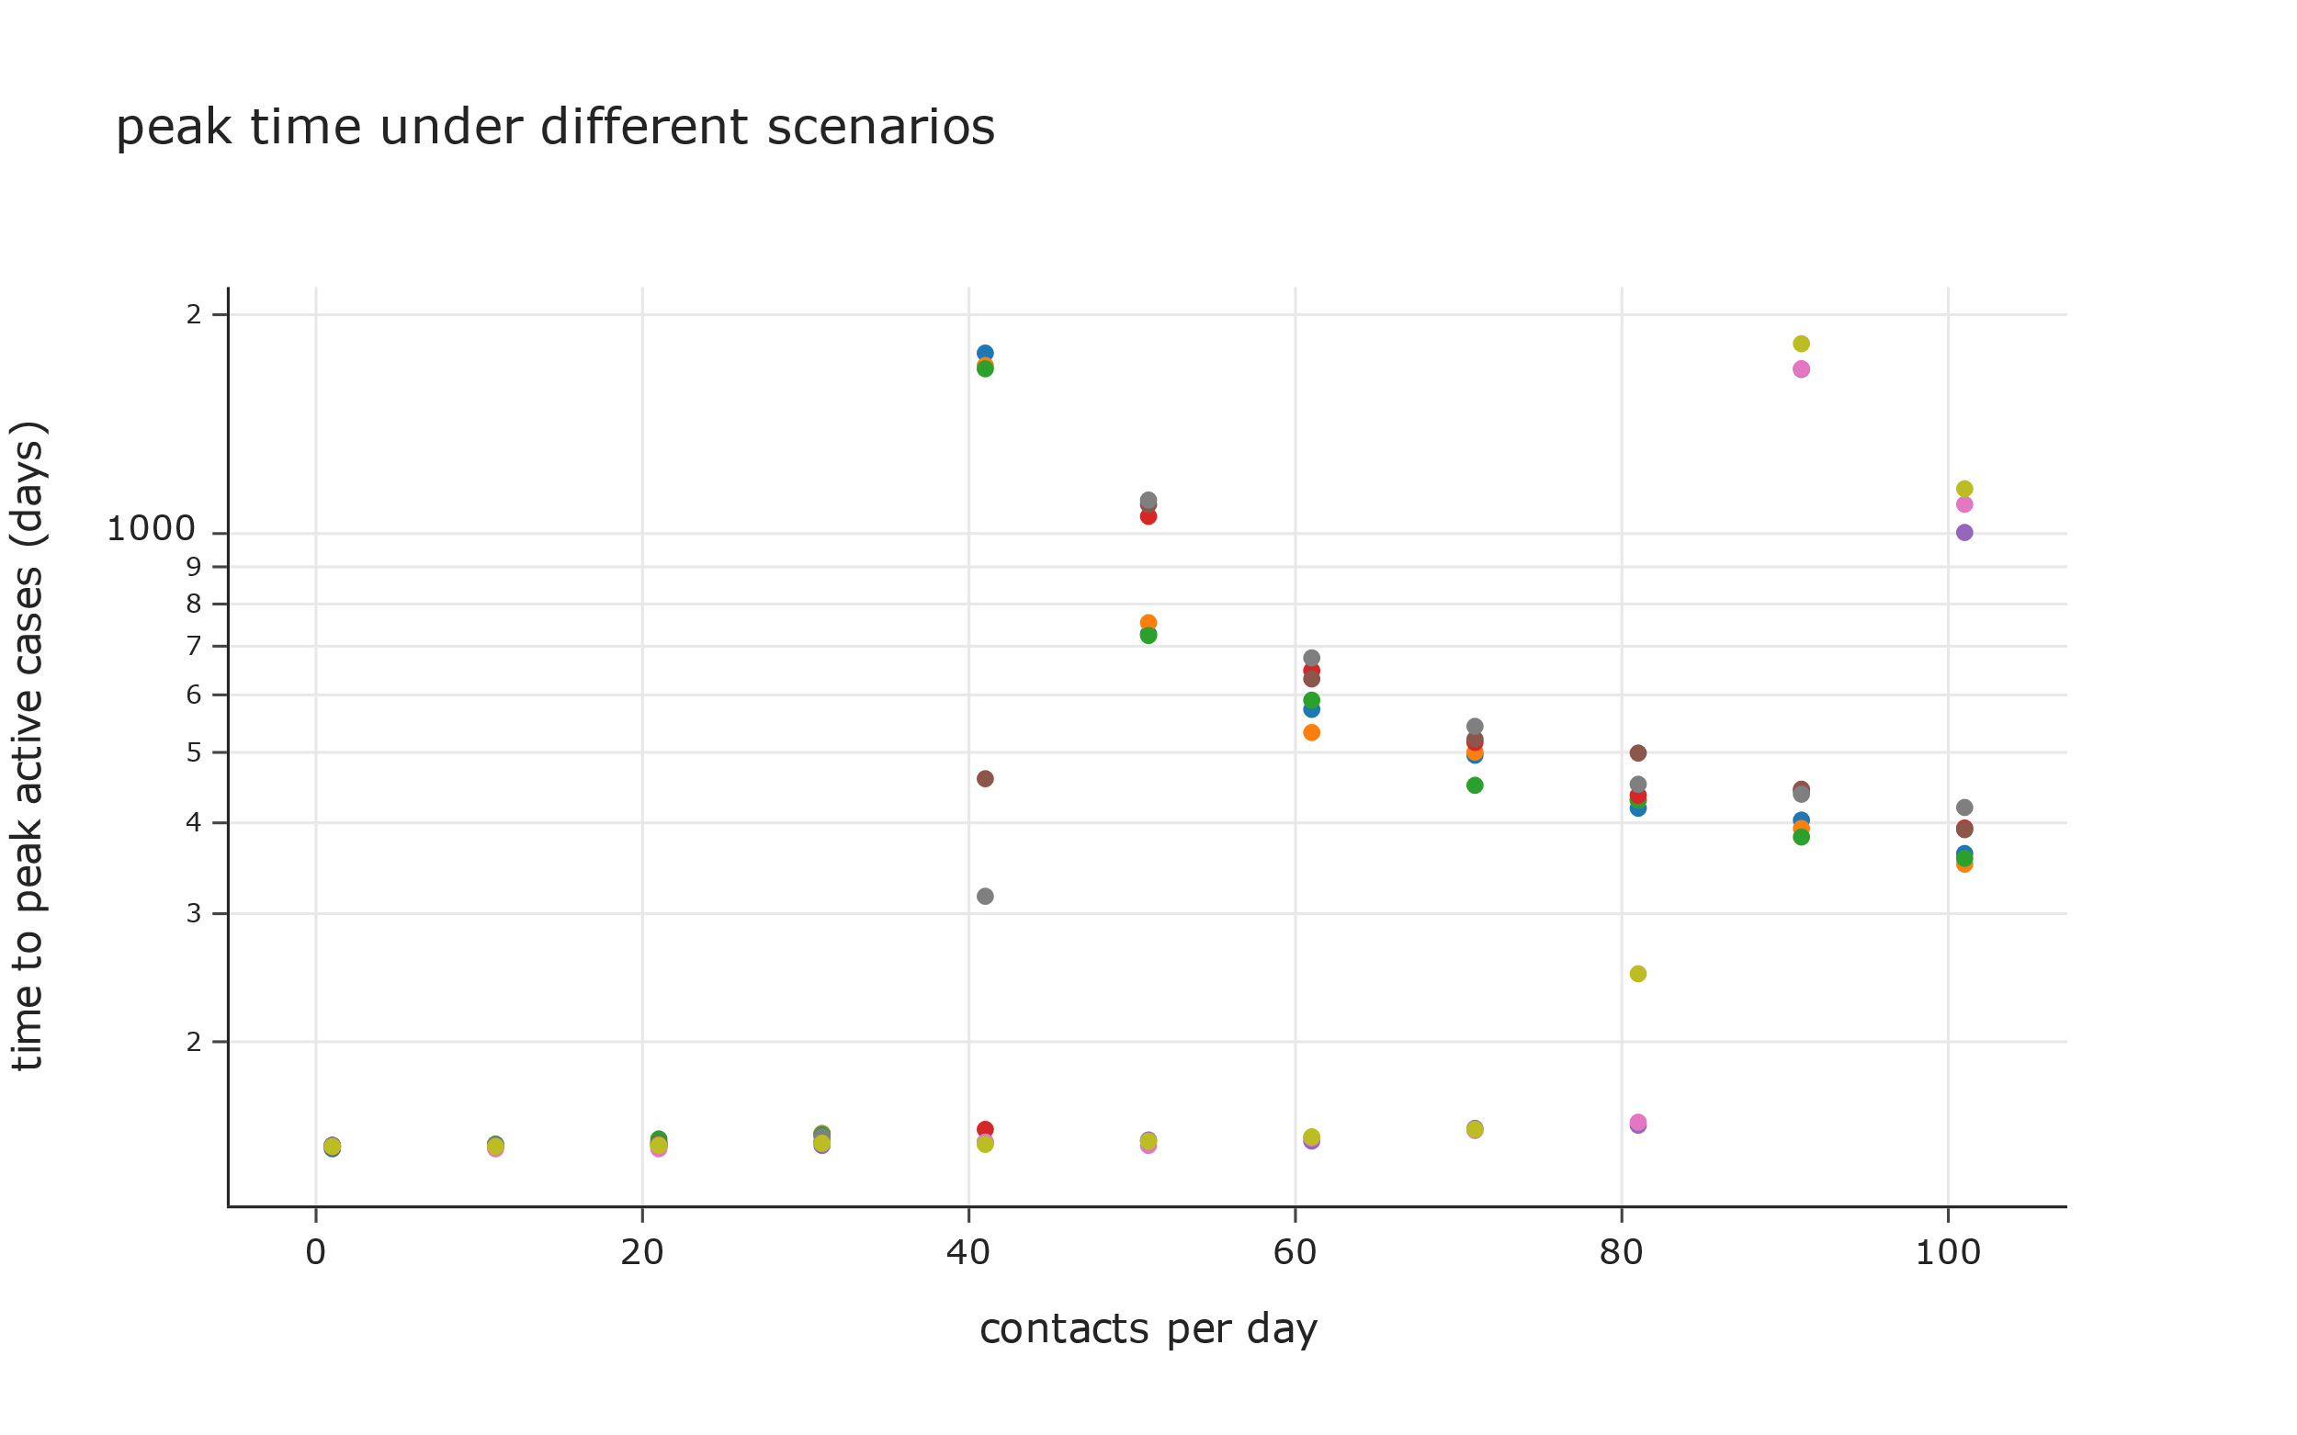
Scenarios where under-capacity of hospitals has no impact on deaths
Scenarios where under-capacity of hospitals has a multiplier effect on deaths

